Slide 1
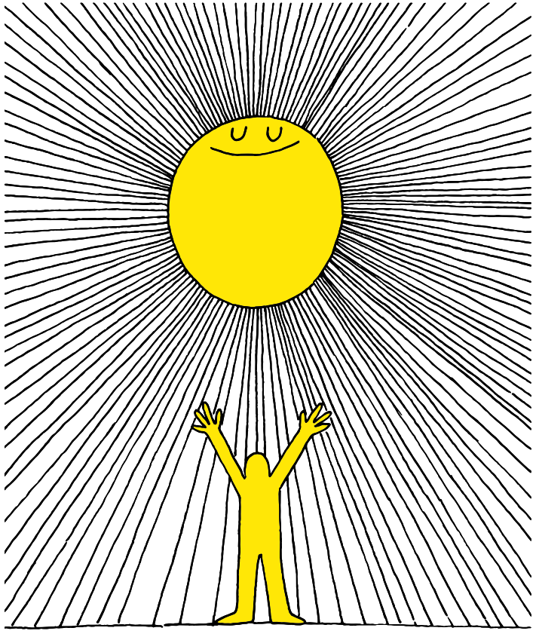

Slide 2
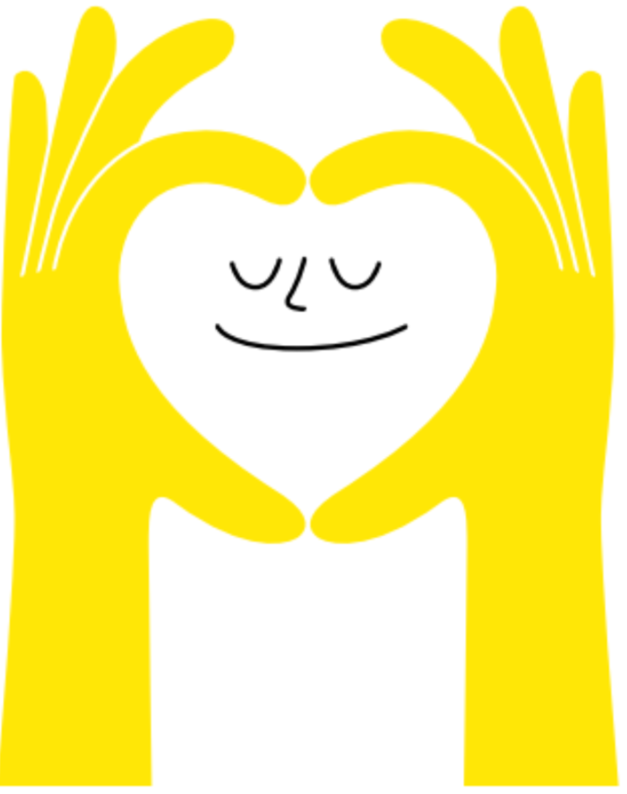
Lesson PowerPoint Table of Contents
Lesson 15: Reflecting on and Celebrating Well-Being
Lesson 14: The Road to Resilience
Slides 3-16
What is resilience?
How is resilience shown?
Can we build resilience?
Slides 17-26
Well-Being review
Well-Being reflection
Well-Being going forward

Slide 3
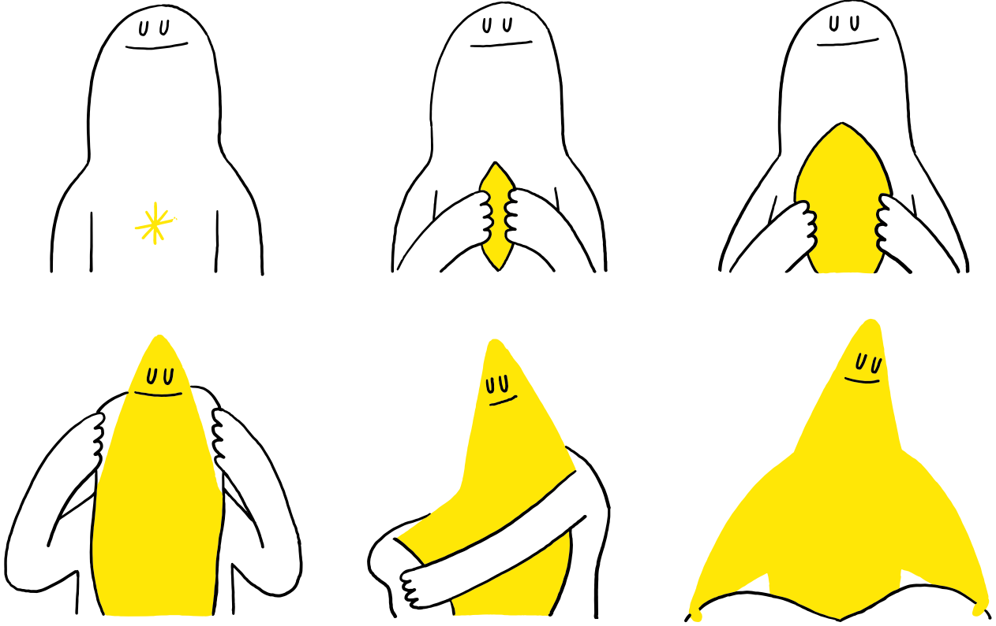
The Road to Resilience

Slide 4
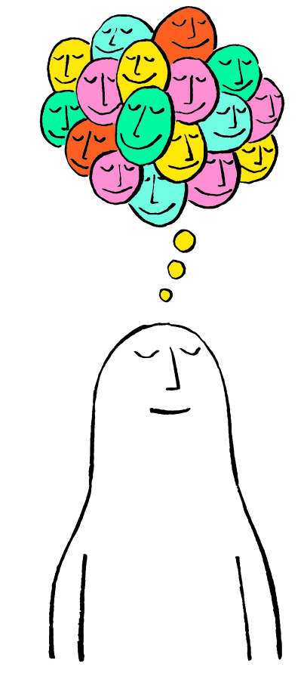
First, find a comfortable seat.
Balloon Breathing
Then, close your eyes or pick a spot on the floor to focus on.
Next, notice what you hear around you.
After you settle into your comfy spot, focus on breathing in through your nose, out through your mouth.
Finally, imagine your belly is a balloon. Fill up nice and round before you exhale. Do this for 2 minutes.

Slide 5
Review
Think-Pair-Share
What is altruism?
How is altruism different than kindness?
How does altruism help build a caring community?
Have you had any new experiences with empathy or compassion?

Slide 6
Video Scenario

Slide 7
Video Response
Independent Writing
As you watched the video, what did you notice about the challenges Sparsh Shah described that he has faced?
How did he overcome them?

Slide 8
Share Out!
Share your writing with a partner or with the class.

Slide 9
What is “Resilience”?
noun
Definition: trying our best, even when things are difficult. Doing well in life despite adversity.
Think-Pair-Share
Use your drawing/writing to use the word resilience or resilient in a sentence.

Slide 10
Share Out!
Popcorn Thoughts
What is adversity? Can you think of any examples?
How does the definition of resilience relate to the video we watched?

Slide 11
Movie Scenario

Slide 12
Movie Scenario Discussion
1. We often want to “runaway” from our problems or challenges. Why is this a natural response to any challenges?
2. Why is “running away” from problems an unhealthy way of coping with challenges?
3. Resiliency means to change yourself by stepping outside of your comfort zone and growing from that experience. How does Moana embrace her uncomfortable emotions and feelings?
4. What is the main lesson from this video that you can take away and apply in your life?

Slide 13
What do you think?
Do you think that you can build resilience or become
more resilient?
If not, why?
If so, how?

Slide 14
Yes You Can!
You can build resilience!
Through practice, believing in yourself, and letting others help you,
you can become more resilient!
Can you think of anything else that can help you be more resilient?
Notes:
Teacher Note: Lead your students to try to get to the word “purpose.” Having a sense of purpose, like we saw in the Sparsh Shah video, feeds resilience

Slide 15
Well-Being Station Rotations
One Good Thing
I am kind, or help others by…
If I have a problem, I can go to…
Station 2: Consider empathy, compassion and altruism—how do you make a difference for others? Write down one idea.
Station 3: When you have a problem or a big worry, write down someone you could go to for help (for example, a parent or coach).
Station 1: Practice gratitude and write down one good thing that happened or you noticed this week.
Notes:
Teacher note: At each station you can have:
- a large piece of chart paper for students to add to the same paper (may want to use sticky notes to reuse the chart paper)
- provide paper for each student so they can do their own work
- get creative! For example, for station 1 they can paint a picture, station 2 they can act out helping others, for station 3 they can retell a time where they had a problem and needed help

Slide 16
Share Out!
How did that activity go for you?
Were there any new ideas or connections that you made?
Do you think it is important to build resilience? Why or why not?

Slide 18
First, find a comfortable seat.
Balloon Breathing
Then, close your eyes or pick a spot on the floor to focus on.
Next, notice what you hear around you.
After you settle into your comfy spot, focus on breathing in through your nose, out through your mouth.
Finally, imagine your belly is a balloon. Fill up nice and round before you exhale. Do this for 2 minutes.

Slide 19
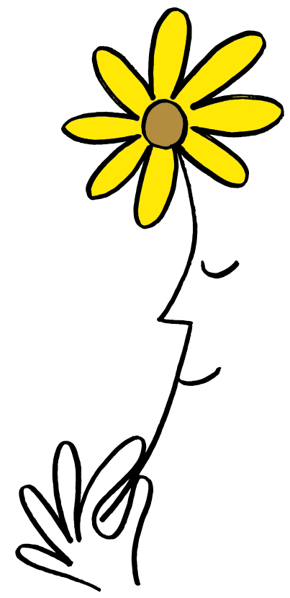
A Walk Down Memory Lane
Think-Pair-Share
What do you know about well-being?
Remember, we learned about:
Mindfulness
Gratitude
Empathy
Compassion
Altruism
Resilience

Slide 20
Reflection
Independent Writing
Write or draw about your experience promoting well-being.
What did you notice about yourself?
What did you notice about others?
What more could you do to promote well-being?
When we’re done, share with a partner!

Slide 21
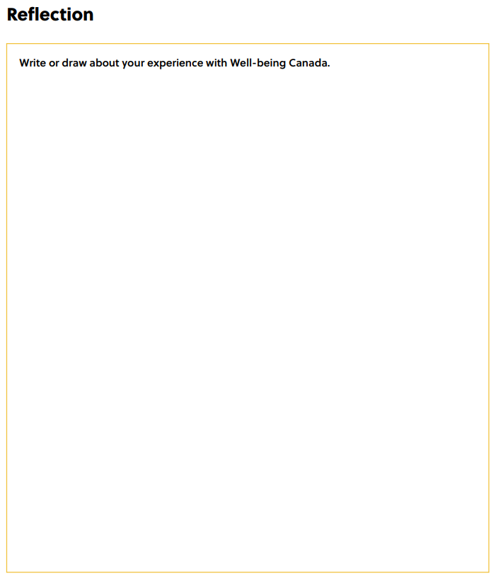
Reflection Sheet
Notes:
Teacher Note: A printable version of this sheet can be found in the lesson package

Slide 22
Share Out!
Popcorn Thoughts
What were your favorite activities?
What is something new that you learned?
Are you doing anything different now to care for your well-being?
Are you helping others care for their well-being?

Slide 23
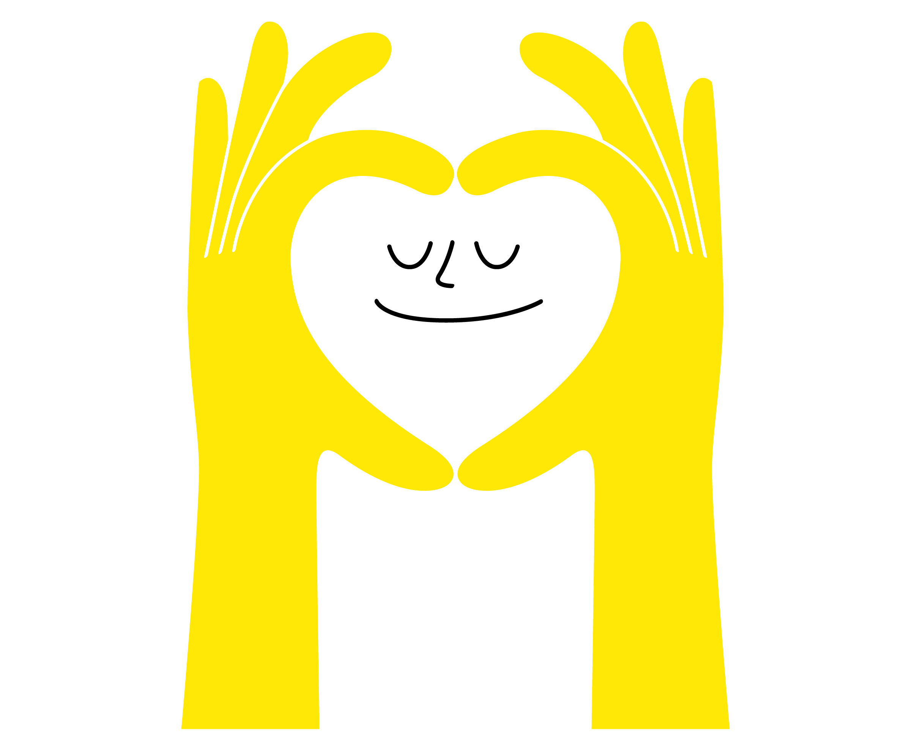
Daily Action
Independent Writing
Draw or write to show how you can add more well-being into your life at school, in your community, and at home.

Slide 24
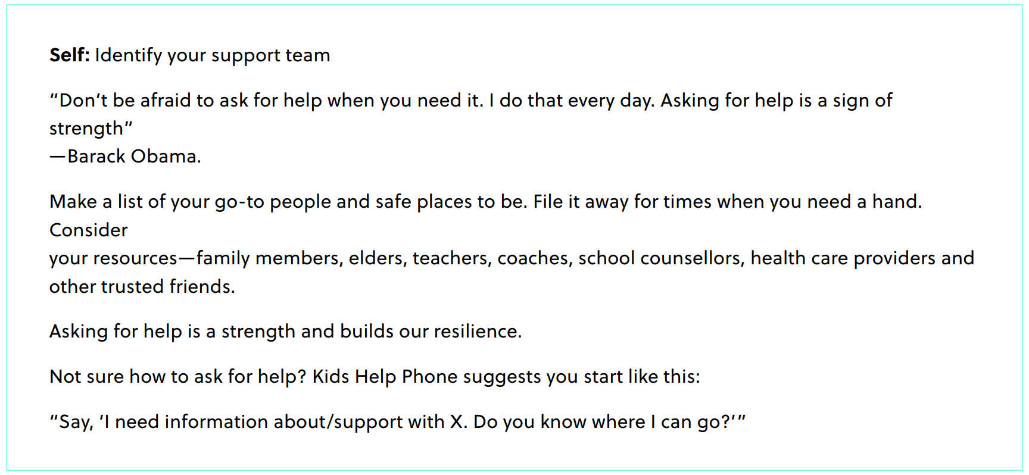
Daily Action

Slide 25
Daily Action

Slide 26
Daily Action

Slide 27
