Slide 1
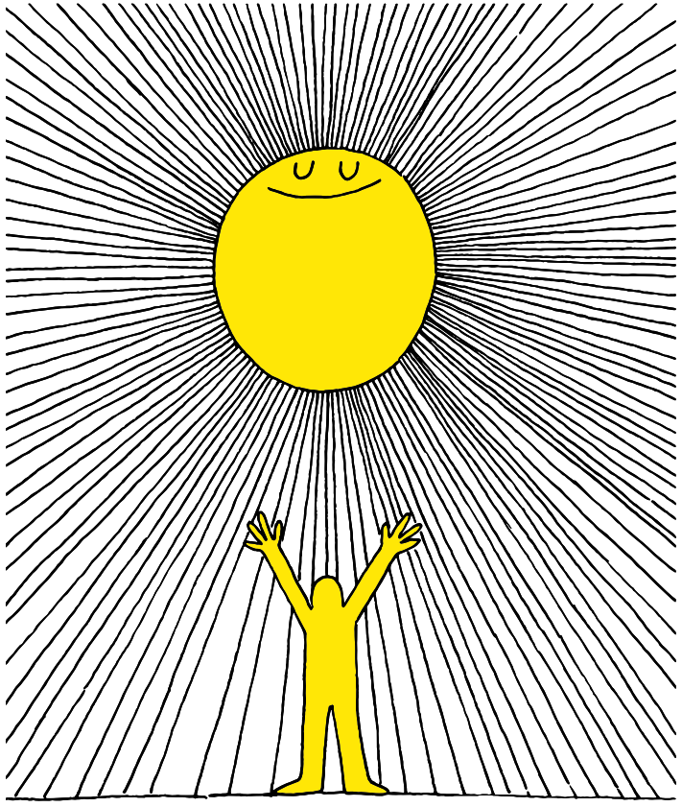
1q

Slide 2
Lesson PowerPoint Table of Contents
Lesson 1: Let’s Get Started
Lesson 2: The Road to Mindfulness
Slides 3-13
What is well-being?
Learning about well-being
Understanding your own well-being
Slides 14-22
What is mindfulness?
Practicing mindfulness
Mindful breathing exercise
Lesson 3: Understanding our Feelings
Lesson 4: Managing our Emotions
Slides 23-31
Reviewing mindfulness
Recognizing feelings
Understanding the effect of our feelings
Slides 32-41
Reviewing mindfulness
Recognizing feelings
Understanding the effect of our feelings

Slide 4
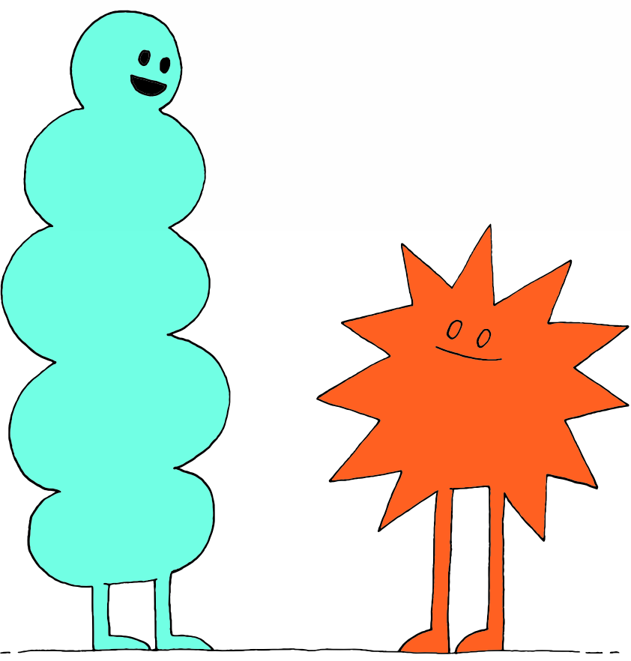
What is “Well-Being”?
Think-Pair-Share
Have you ever heard of “well-being” before?
What do you think it is?
Where have you heard about it?

Slide 5
What is “Well-Being”?
noun
Definition: The state of being comfortable, happy, or healthy
Think-Pair-Share
When do you feel comfortable, happy, or healthy?

Slide 6
What is “Well-Being”?
Look like? What do you see when people are comfortable, happy, and healthy? | Sound like? What do you hear when people are comfortable, happy, and healthy? | Feel like? What do you feel when YOU are comfortable, happy, and healthy?

Slide 7
Difficult Feelings
Part of well-being is being able to manage difficult feelings…
Think-Pair-Share
What are difficult feelings?
What are some things that help us when we have difficult feelings?
Why do you think it’s important to do these things?

Slide 8
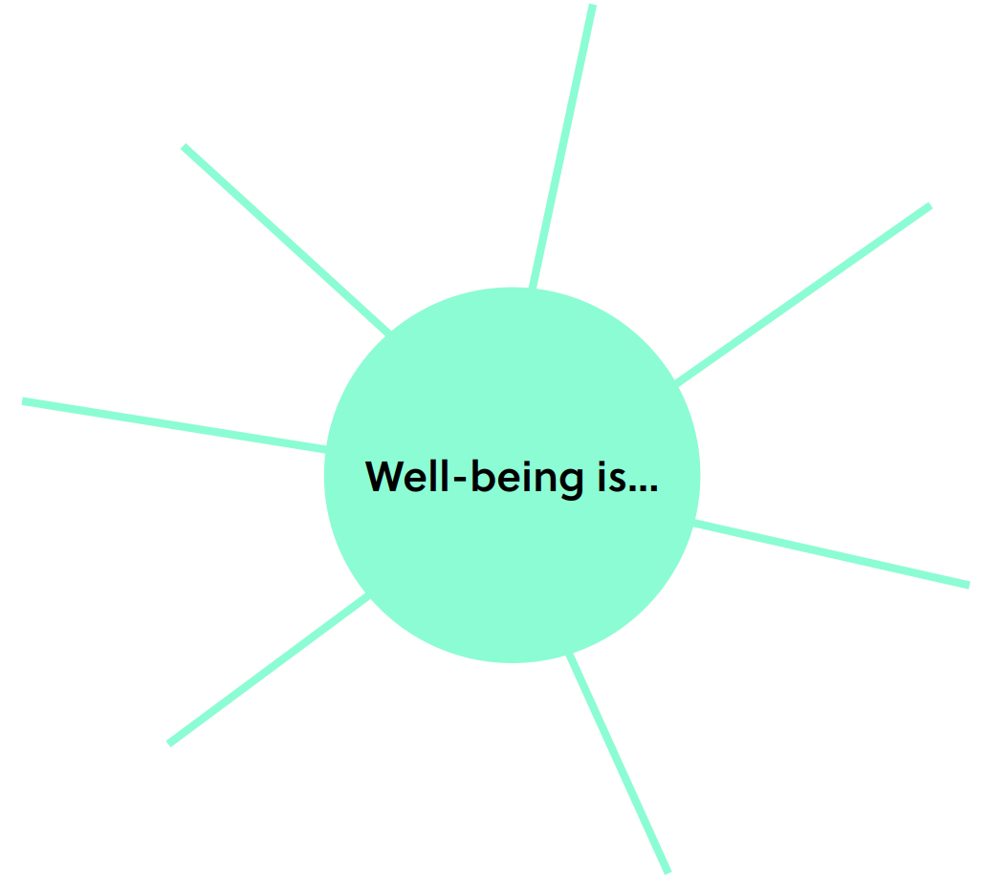
Well-Being is…
Do you think there are ways to increase well-being?
Notes:
Teacher notes: There is a printable version of this bubble map in our Well-Being Canada resources, so you can…
- Print the web out and have your students complete this independently first
- Print the web out and have students complete in partners or small groups first
- Project the web on your board and complete together as a class
The following slide shows sample answers so your class can compare your answers with ours!

Slide 9
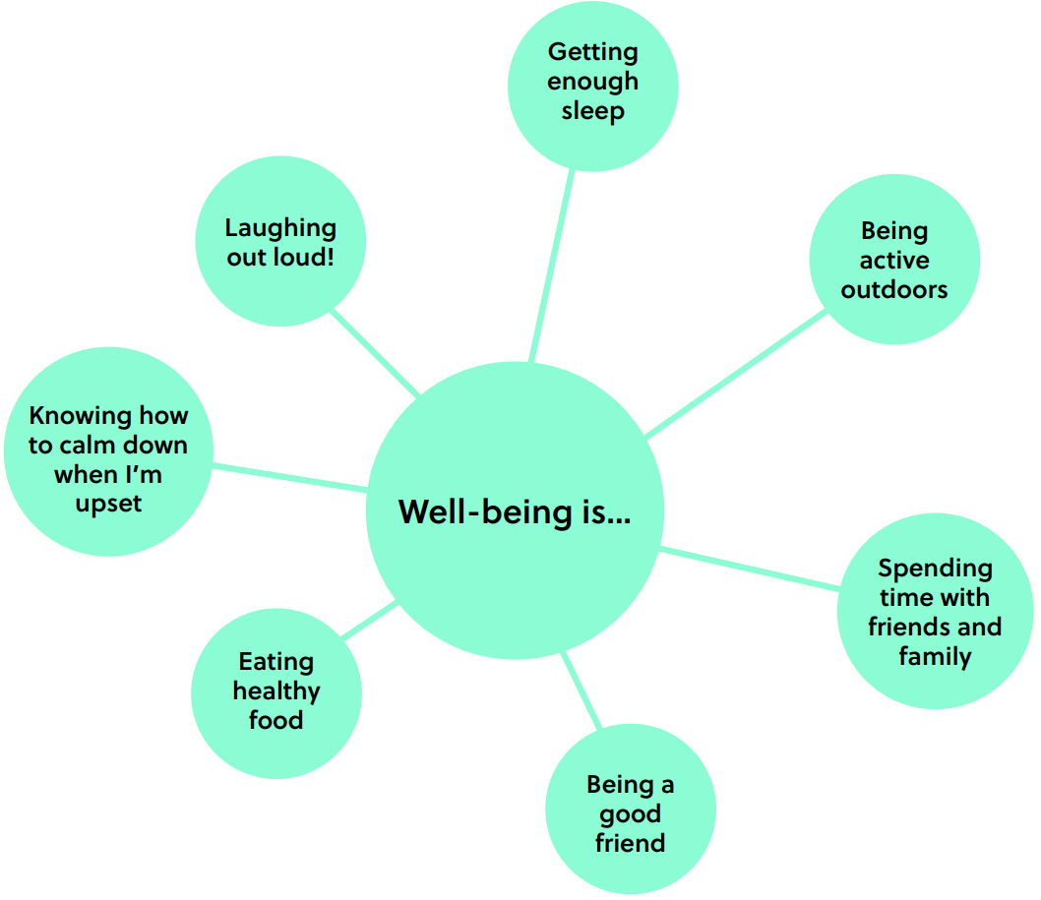
Well-Being is…
See how your answers compare to ours!

Slide 10
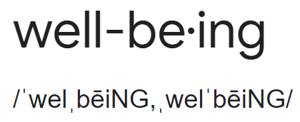
Well-Being Definitions
Remember the dictionary definition of well-being…
noun
Definition: The state of being comfortable, happy, or healthy
Think-Pair-Share
What would YOUR definition of well-being be?
Let’s make a definition as a class!

Slide 11
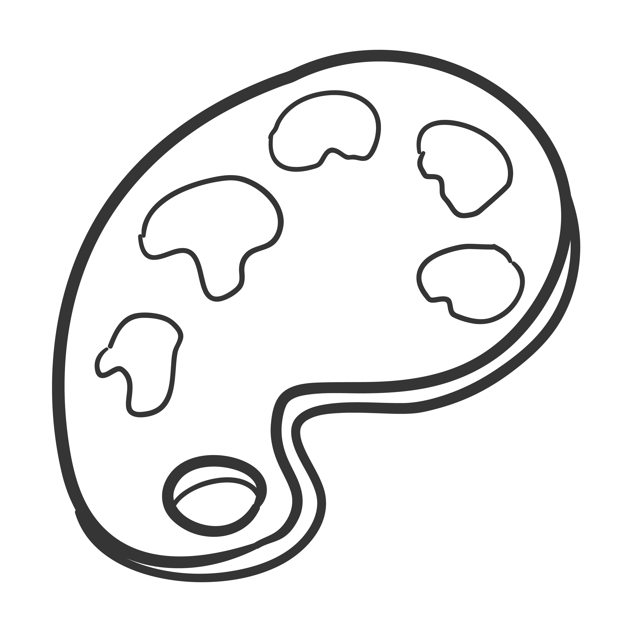
YOUR Well-Being!
Share Out!
Share your work about what well-being looks like for you!
Notes:
Teacher note: Let your students be creative here! They can draw, paint, build with Play-doh, or write- whatever you would like to offer them to be able to do!

Slide 12
YOUR Well-Being!
Independent Work
What does well-being look like for you?
Notes:
Teacher note: Let your students be creative here! They can draw, paint, build with Play-doh, or write- whatever you would like to offer them to be able to do!

Slide 13
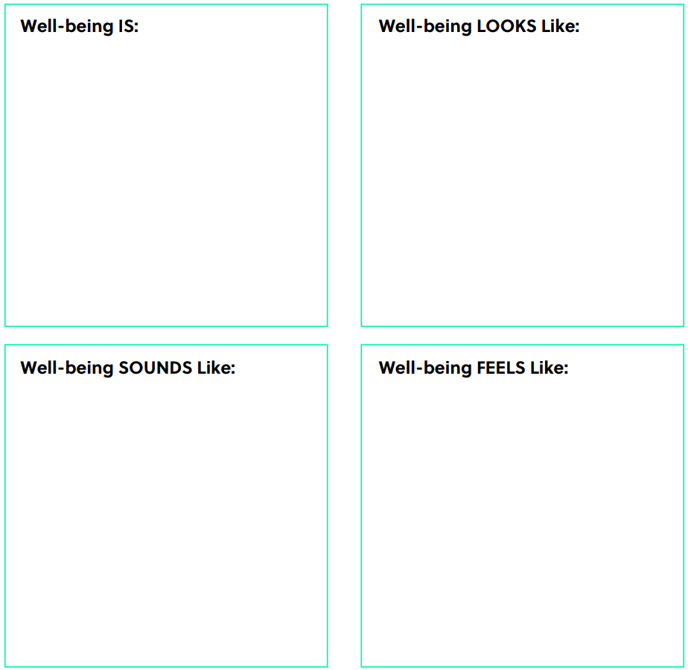
Notes:
Teacher Note: A printable version of this sheet can be found in the lesson package

Slide 14
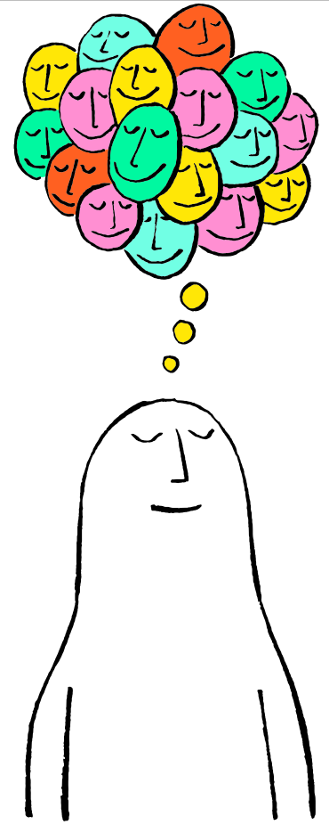

Slide 15
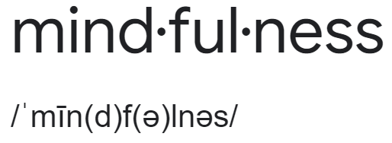
What is Mindfulness?
noun
Definition: Paying full attention to something. It means slowing down to really notice what you’re doing.
Think-Pair-Share
What do you think this means?
Can you give an example?

Slide 16
Let’s Practice!

Slide 17
Review
Mindfulness is…
paying full attention to something
slowing down to really notice what you’re doing
the opposite of rushing or multitasking
taking your time
focusing in a relaxed, easy way

Slide 18
Tasting with Mindfulness
Today we’re going to taste with mindfulness by focusing our full attention on our food one step at a time.
Just look at your food…
Just smell your food…
Put your food in your mouth, but don’t bite yet…
Bite into your food and chew slowly…
Notice all the different things you see
Notice what you smell
Notice the texture:
Is it rough or smooth?
Notice how it tastes and enjoy thinking about it
Do you see anything you like or don’t like?
What does it smell like?
Does it smell familiar?
Say a quiet “thank you” to everyone who brought this food to you
Can you taste it without biting it?
How do you feel after trying this mindfulness activity?
What did you notice?

Slide 19
Mindful Breathing
Now, we’re going to try a very short exercise that will help us to be mindful and also can be helpful in calming our bodies and minds.

Slide 20
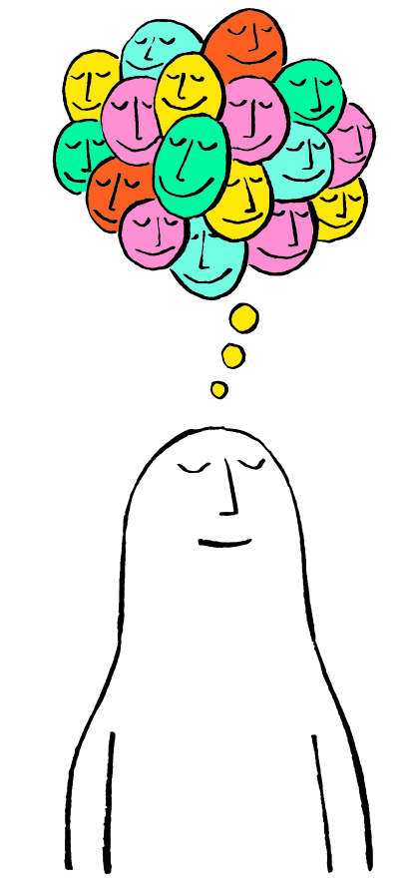
First, find a comfortable seat.
Balloon Breathing
Then, close your eyes or pick a spot on the floor to focus on.
Next, notice what you hear around you.
After you settle into your comfy spot, focus on breathing in through your nose, out through your mouth.
Finally, imagine your belly is a balloon. Fill up nice and round before you exhale. Do this for 2 minutes.

Slide 21
Mindful Breathing
Think-Pair-Share
What did you notice while you were deep belly breathing?

Slide 22
Mindful Practices
Additional Mindfulness Awareness Practices:
Mindful movement
Mindful walking
Mindful in nature
Mindful art
Mindful communication
Think-Pair-Share
What do you think these mindful awareness practices are like?

Slide 24
Review
Think-Pair-Share
What is well-being?
What is mindfulness?

Slide 25
First, find a comfortable seat.
Balloon Breathing
Then, close your eyes or pick a spot on the floor to focus on.
Next, notice what you hear around you.
After you settle into your comfy spot, focus on breathing in through your nose, out through your mouth.
Finally, imagine your belly is a balloon. Fill up nice and round before you exhale. Do this for 2 minutes.

Slide 26
Feelings and Well-Being
Today’s topic is understanding our feelings.
Understanding our feelings is another practice that contributes to well-being.

Slide 27
What Affects our Feelings?
Many things can affect how you are feeling…
The weather
If you slept well
The people you are with
Whether or not you’re hungry
What activities you’ve been doing
Think-Pair-Share
Can you think of any other things that can affect how you are feeling?

Slide 28
How are you Feeling Today?
Take a few moments to be mindful of how you are feeling today and why you feel that way.
Draw and/or write about how you feel and why.
Notes:
Teacher note: Let your students be creative here! They can draw, paint, build with Play-doh, or write- whatever you would like to offer them to be able to do!

Slide 29
Listening to My Body by Gabi Garcia
As you watch, think about if you can connect with any of the feelings in the story…
Follow-up question: Did you connect with any of the feelings in the story?

Slide 30
Feelings and your Body and Thoughts
Feeling | Body How does your body feel when you have this feeling? | Thoughts What thoughts do you have when you have this feeling?
ex. Sad | Slow, tired, crying | “Why did that happen?”
Happy
Worried
Excited
Angry

Slide 31
We’re all Different!
Not everyone has the same physical sensations or thoughts when experiencing a certain feeling.
Think-Pair-Share
Why is it important to know that other people might experience feelings in a different way than we experience them?
How could it be helpful to understand how feelings
show up in our bodies (and thoughts)?

Slide 33
First, find a comfortable seat.
Balloon Breathing
Then, close your eyes or pick a spot on the floor to focus on.
Next, notice what you hear around you.
After you settle into your comfy spot, focus on breathing in through your nose, out through your mouth.
Finally, imagine your belly is a balloon. Fill up nice and round before you exhale. Do this for 2 minutes.

Slide 34
How are you Feeling Today?
Remember, many things can affect how you are feeling…
The weather
If you slept well
The people you are with
Whether or not you’re hungry
What activities you’ve been doing
Take a few moments to be mindful of how you are feeling today and why you feel that way.
Draw and/or write about how you feel and why

Slide 35
How are you Feeling Today?
Think-Pair-Share
What feeling did you draw/write about today?

Slide 36
Difficult Feelings
Knowing our feelings and how they show up in our bodies helps us understand why we feel that way and how to feel better.
For example, if I start to feel upset, I might say “I am angry right now” and I might think, “Hmm, when I’m angry, my face feels hot and my fists get tight and I feel like yelling!”
This helps me remember that I won’t stay angry forever and handle the problem, instead of just feeling angry.

Slide 37
Wilma Jean Worry Machine by Julia Cook

Slide 38
Wilma Jean Worry Machine by Julia Cook
Think-Pair-Share
What are some of the things Wilma Jean was
worried about?
Have you ever felt like you had the “worry flu?” What
did it feel like?
What helped Wilma Jean in the story?
What happened when Wilma Jean shared her worries with her teacher?

Slide 39
What is Stress?
noun
Definition: What you feel when you are worried or uncomfortable about something.
Stress gets turned on in our brains when we sense a problem.
The tricky part is, it gets turned on whether the problem is BIG or small, so we can get stressed out by things that aren’t a big problem at all!

Slide 40
Relieving your Stress
Think-Pair-Share
What helps you and makes you feel more
comfortable when you are stressed, upset or
worried?
It can be a person, place, thing, or action!
These things are “tools” in your “comfort toolbox”!

Slide 41
Comfort Toolbox
Draw/write about what comforts you when you feel stressed or upset.
These are the things in your “Comfort Toolbox.”
Using them, or even thinking about them, when you are stressed or upset can help you feel better!
You can also comfort your body with getting in a comfortable position and taking bubble breaths!

Slide 42
