Slide 1
1q

Slide 2
Lesson PowerPoint Table of Contents
Lesson 10: The Road to Altruism
Lesson 11: Acting with Altruism
Slides 3-10
What is altruism?
Altruism and well-being
Acting with altruism
Slides 11-15
Altruism share out
Who needs altruism?
How can we show altruism?
Lesson 13: Reflecting and Celebrating Altruism
Lesson 12: Altruism in Action
Slides 16-19
Carrying out altruism
Slides 20-26
Altruism reflection
Spreading altruism

Slide 4
First, find a comfortable seat.
Balloon Breathing
Then, close your eyes or pick a spot on the floor to focus on.
Next, notice what you hear around you.
After you settle into your comfy spot, focus on breathing in through your nose, out through your mouth.
Finally, imagine your belly is a balloon. Fill up nice and round before you exhale. Do this for 2 minutes.

Slide 5
An Altruistic Memory
Independent Writing
Think about a time where someone did something kind for you.
Once you’re settled in your memory, draw or write about it and how it made you feel.

Slide 6
What is “Altruism”?
noun
Definition: when we care about others and do kind acts that help them even though we don’t get anything in return by doing those acts.
Think-Pair-Share
Was the person from your drawing/writing showing altruism?
Why do we do kind things for others?

Slide 7
Share Out!
What are your thoughts about altruism?
How do you think altruism might help us with our well-being?

Slide 8
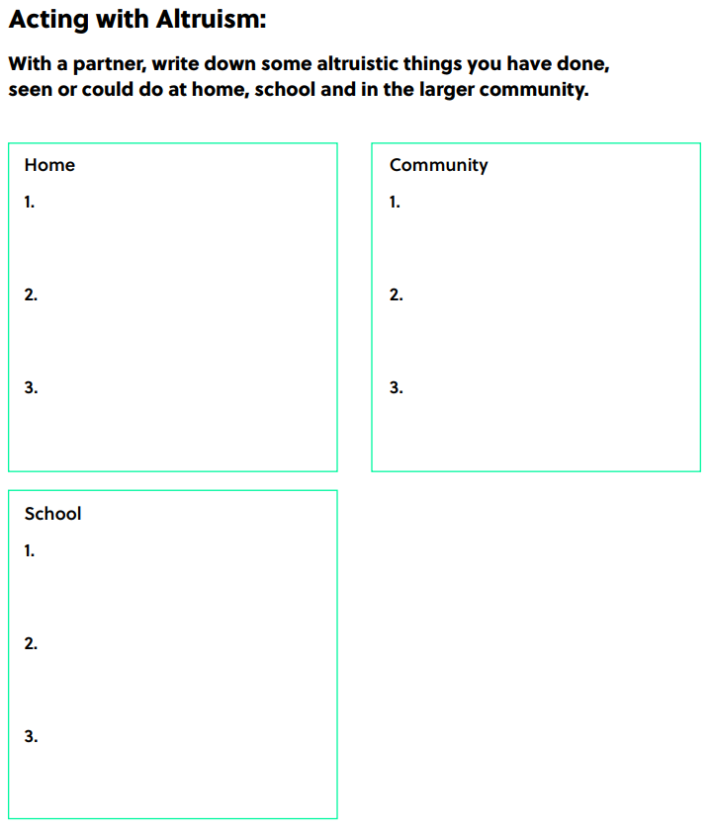
Partner Work option 1
Notes:
Teacher Note: A printable version of this sheet can be found in the lesson package

Slide 9
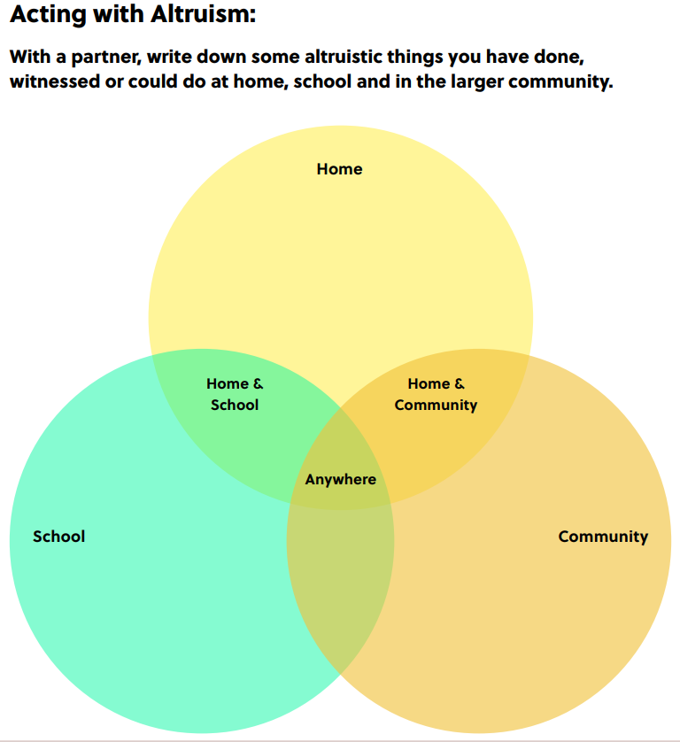
Partner Work option 2
Notes:
Teacher Note: A printable version of this sheet can be found in the lesson package

Slide 10
Class Altruism Brainstorm
Home:
How can you show altruism at home?
Community:
How can you show altruism in your community?
School:
How can you show altruism at school?

Slide 12
First, find a comfortable seat.
Balloon Breathing
Then, close your eyes or pick a spot on the floor to focus on.
Next, notice what you hear around you.
After you settle into your comfy spot, focus on breathing in through your nose, out through your mouth.
Finally, imagine your belly is a balloon. Fill up nice and round before you exhale. Do this for 2 minutes.

Slide 13
Opportunities to Help
Brainstorm:
Who in our school/community could use help/kindness?
Examples: new students feeling welcome, people experiencing food insecurity needing food donations
Class Choice:
Who do we want to help first?

Slide 14
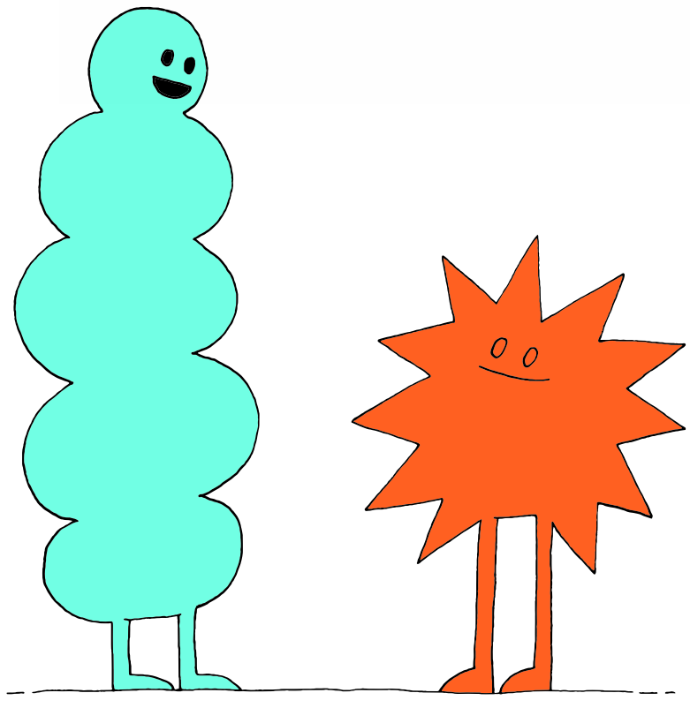
Partner Action Plan
Think-Pair-Share
How can we act with altruism towards the person/people we chose?
Examples: make new student welcome kits, collect food for a food bank

Slide 15
Class Action Plan
Brainstorm:
How can we act with altruism towards the person/people we chose?
Class Choice:
How do we want to show altruism?

Slide 16
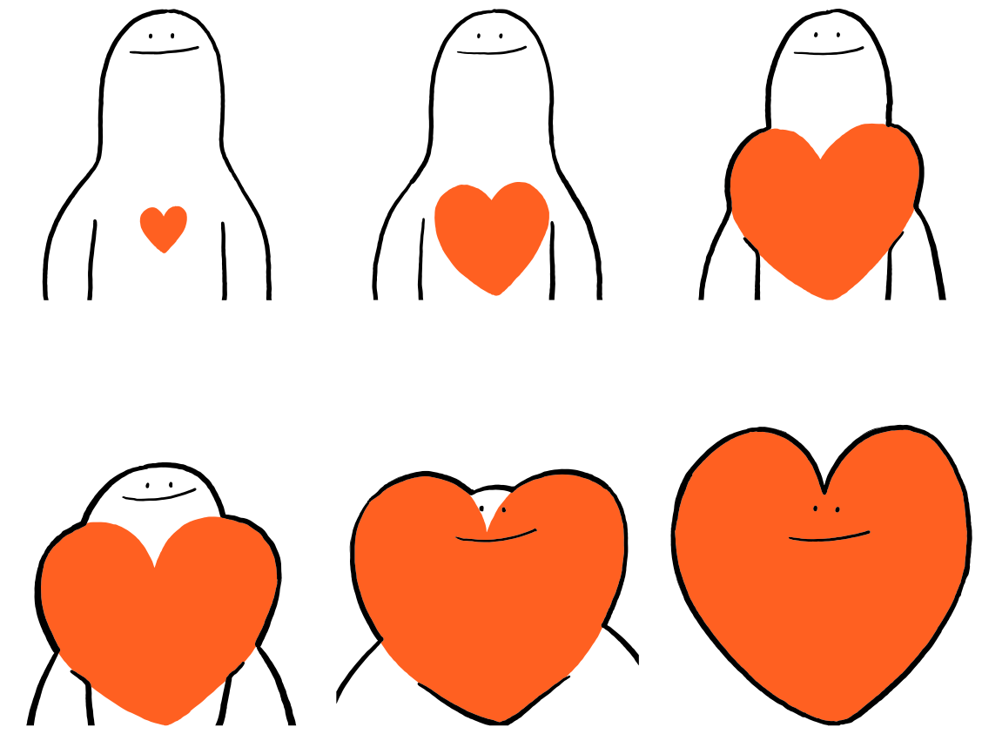

Slide 17
First, find a comfortable seat.
Balloon Breathing
Then, close your eyes or pick a spot on the floor to focus on.
Next, notice what you hear around you.
After you settle into your comfy spot, focus on breathing in through your nose, out through your mouth.
Finally, imagine your belly is a balloon. Fill up nice and round before you exhale. Do this for 2 minutes.

Slide 18
Take Action!
Let's put our altruism plan into action!
Notes:
Teacher Note: Try to keep this activity fun and lighthearted! Practicing altruism should be enjoyable and make you want to practice it more and more!

Slide 19
Altruism Review
noun
Definition: when we care about others and do kind acts that help them even though we don’t get anything in return by doing those acts.
Think-Pair-Share
What does altruism mean to you in your own words?
Why are we practicing altruism?

Slide 21
First, find a comfortable seat.
Balloon Breathing
Then, close your eyes or pick a spot on the floor to focus on.
Next, notice what you hear around you.
After you settle into your comfy spot, focus on breathing in through your nose, out through your mouth.
Finally, imagine your belly is a balloon. Fill up nice and round before you exhale. Do this for 2 minutes.

Slide 22
A Walk Down Memory Lane
Think-Pair-Share
Who did we choose to show altruism to and why?
What was your favourite memory from our altruistic action?
How can you keep showing altruism each day?

Slide 23
Reflection
Independent Writing
Write or draw about your experience with our altruism action.
What did you do?
How did it feel to work together as a class?
How are you feeling now after our work together?
How could acting with altruism impact your own well-being?

Slide 24
Reflection Sheet
Notes:
Teacher Note: A printable version of this sheet can be found in the lesson package

Slide 25
Share Out!
Popcorn Thoughts
How did you feel during our experience with altruism?
How do you think acting with altruism could be good for our well-being?
How do you think the receiver of our altruism felt?

Slide 26
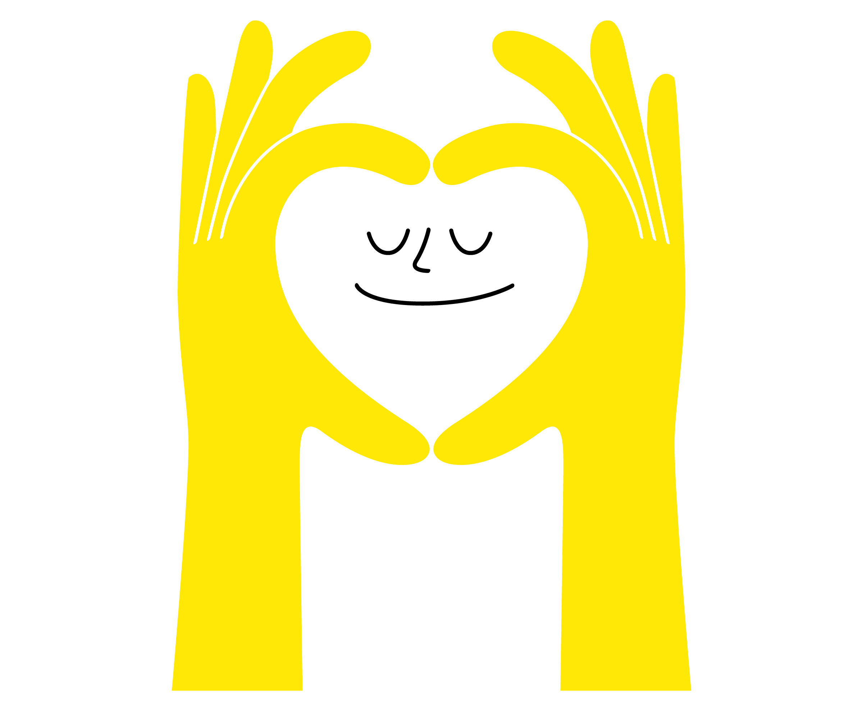
Daily Action
Independent Writing
Draw or write to show how you can add more altruism into your life at school, in your community,
and at home.

Slide 27
