Slide 1
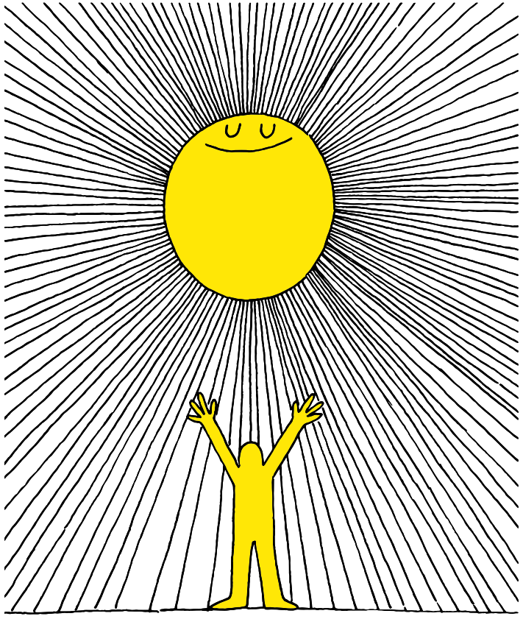
1q

Slide 2
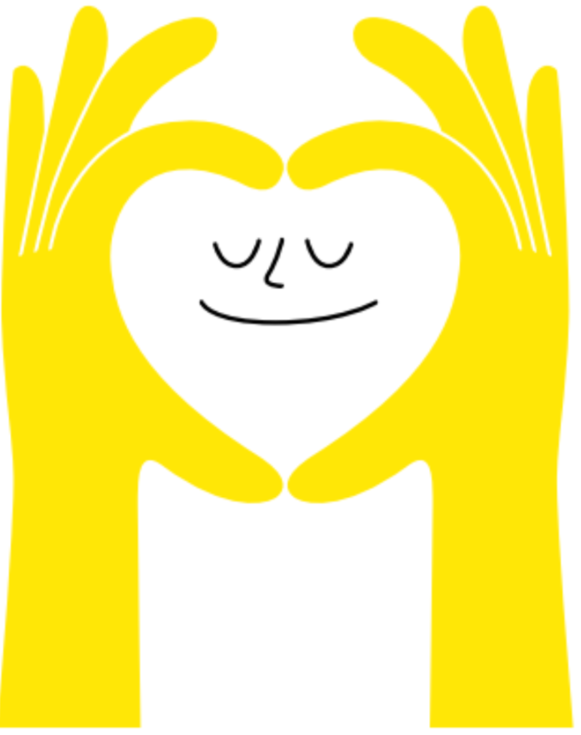
Lesson PowerPoint Table of Contents
Lesson 15: Reflecting on and Celebrating Well-Being
Lesson 14: The Road to Resilience
Slides 3-14
What is resilience?
How is resilience shown?
Can we build resilience?
Slides 15-21
Well-Being review
Well-Being reflection
Well-Being going forward

Slide 3
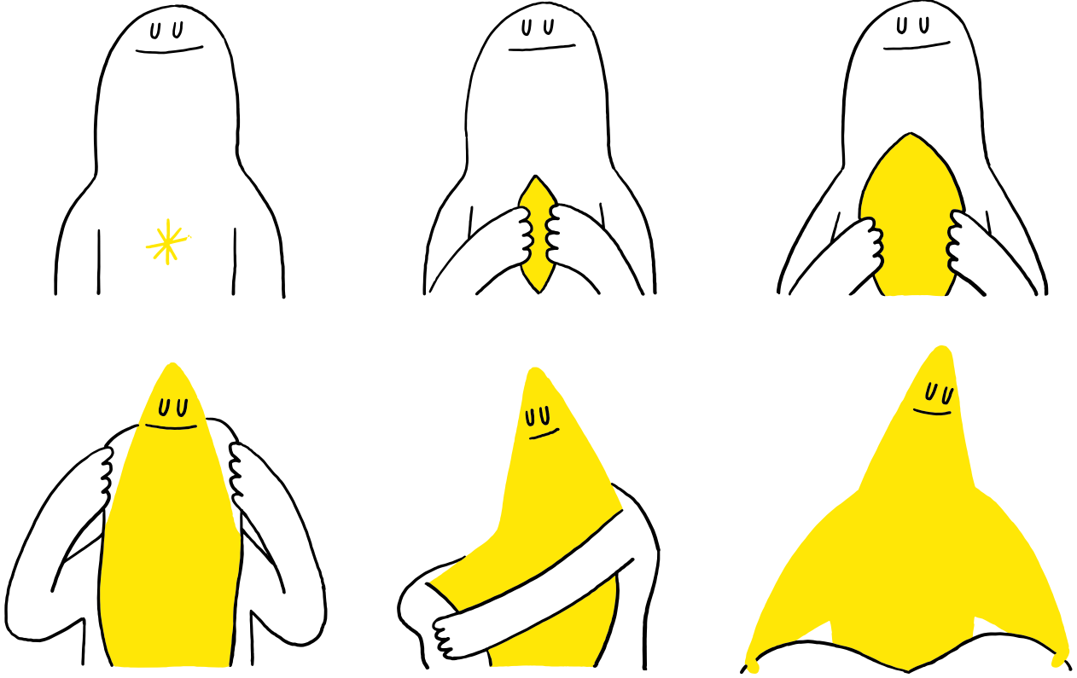
The Road to Resilience

Slide 4
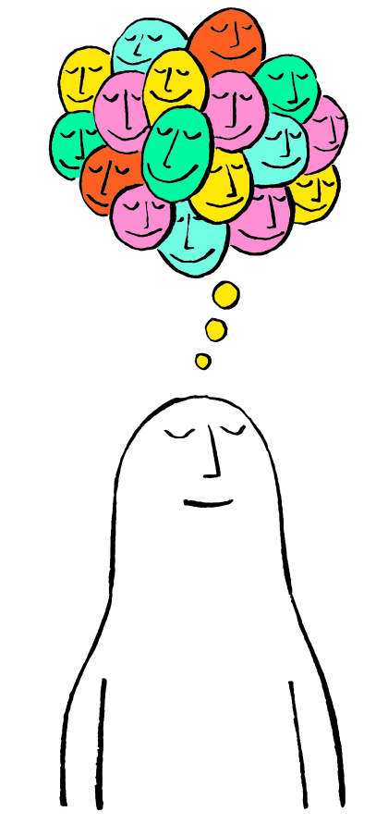
First, find a comfortable seat.
Balloon Breathing
Then, close your eyes or pick a spot on the floor to focus on.
Next, notice what you hear around you.
After you settle into your comfy spot, focus on breathing in through your nose, out through your mouth.
Finally, imagine your belly is a balloon. Fill up nice and round before you exhale. Do this for 2 minutes.

Slide 5
Review
Think-Pair-Share
What is empathy? What is compassion?
Have you had any new experiences with empathy or compassion?

Slide 6
Pete the Cat: I Love My White Shoes by Eric Litwin
As you watch, think about how Pete overcomes obstacles in the story.

Slide 7
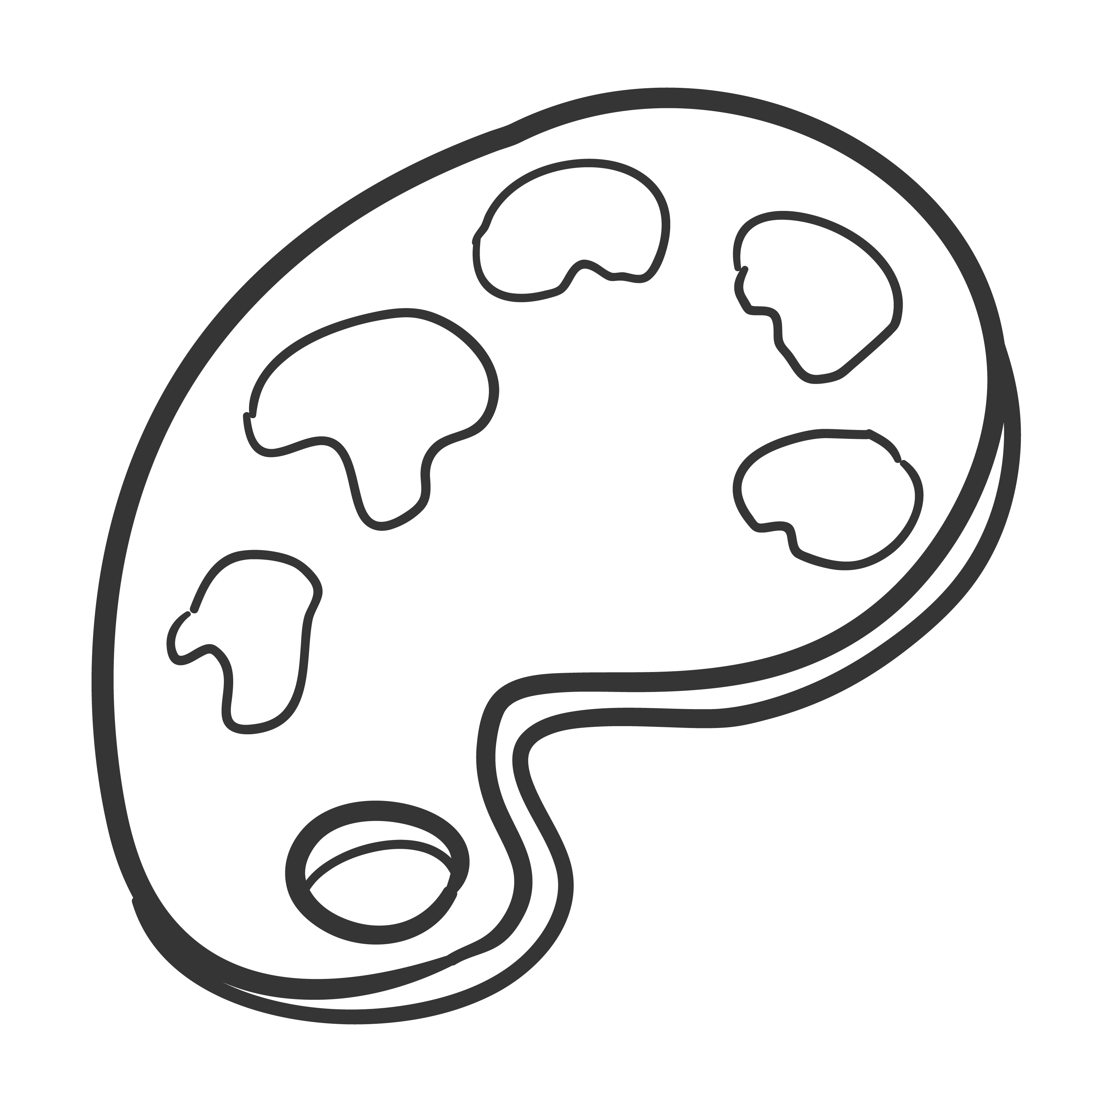
Reading Response
Independent Writing
How did Pete respond when he kept messing up his shoes?
Draw or write about a time something was hard but you kept on going!

Slide 8
Share Out!
Can challenges or difficulties ever be good for us?
What does it mean to not give up?

Slide 9
What is “Resilience”?
noun
Definition: trying our best, even when things are difficult.
Think-Pair-Share
Use your drawing/writing to use the word resilience or resilient in a sentence.

Slide 10
Share Out!
Popcorn Thoughts
How did you think resilience is good for our well-being?
How do you show resilience when things are hard? What do you do, feel, say, and think?

Slide 11
True or False?
Thumbs up if you think this is true, thumbs down if you think this is false…
People can get better at being resilient.
Notes:
Teacher Note: If your students haven’t heard “true or false” before or may not understand the thumbs up/down correlation, consider doing a few practice questions first

Slide 12
True or False?
That’s true!
Through practice, believing in yourself, and letting others help you, you can become more resilient!
Can you think of anything else that can help you be more resilient?

Slide 13
Well-Being Station Rotations
One Good Thing
I am kind, or help others by…
If I have a problem, I can go to…
Station 1: Write or draw one good thing you are grateful for this week.
Station 2: Write or draw to finish the sentence starter above.
Station 3: Write or draw to finish the sentence starter above.
Notes:
Teacher note: At each station you can have:
- a large piece of chart paper for students to add to the same paper (may want to use sticky notes to reuse the chart paper)
- provide paper for each student so they can do their own work
- get creative! For example, for station 1 they can paint a picture, station 2 they can act out helping others, for station 3 they can retell a time where they had a problem and needed help

Slide 14
Share Out!
What was your favorite thing from our well-being station rotations? Why?
Were there any new ideas you had?
Why do you think it’s important to build resilience?

Slide 16
First, find a comfortable seat.
Balloon Breathing
Then, close your eyes or pick a spot on the floor to focus on.
Next, notice what you hear around you.
After you settle into your comfy spot, focus on breathing in through your nose, out through your mouth.
Finally, imagine your belly is a balloon. Fill up nice and round before you exhale. Do this for 2 minutes.

Slide 17
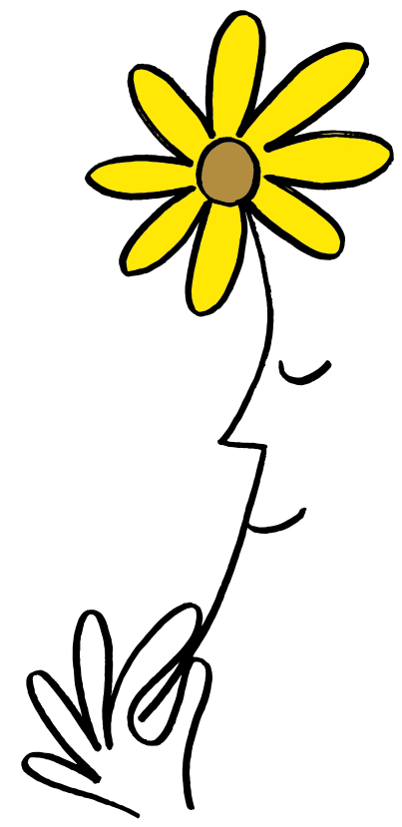
A Walk Down Memory Lane
Think-Pair-Share
What do you know about well-being?
Remember, we learned about:
Mindfulness
Gratitude
Empathy
Compassion
Altruism
Resilience

Slide 18
Reflection
Independent Writing
Write or draw about your experience promoting well-being.
What did you notice about yourself?
What did you notice about others?
What more could you do to promote well-being?
When we’re done, share with a partner!

Slide 19
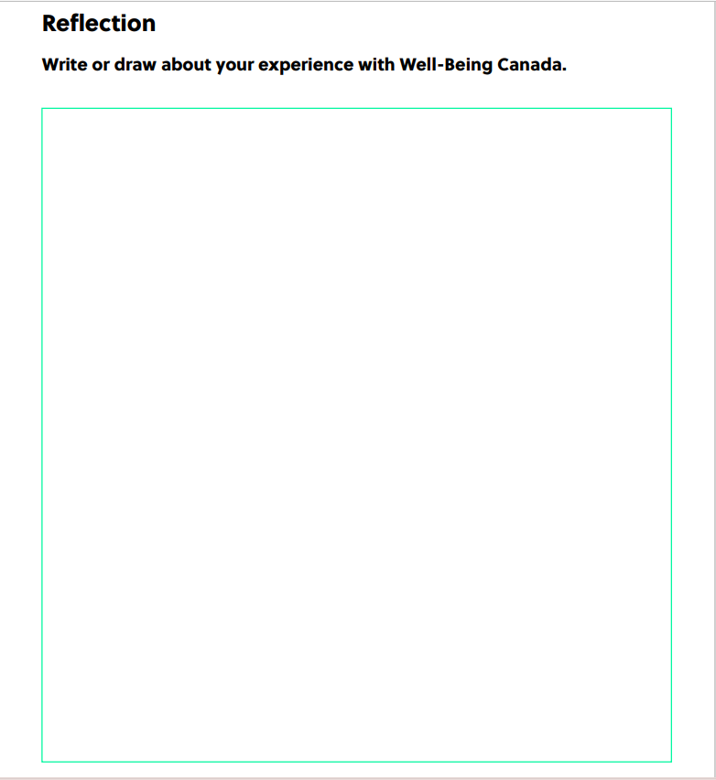
Reflection Sheet
Notes:
Teacher Note: A printable version of this sheet can be found in the lesson package

Slide 20
Share Out!
Popcorn Thoughts
What were your favorite activities?
What is something new that you learned?
Are you doing anything different now to care for your well-being?
Are you helping others care for their well-being?

Slide 21
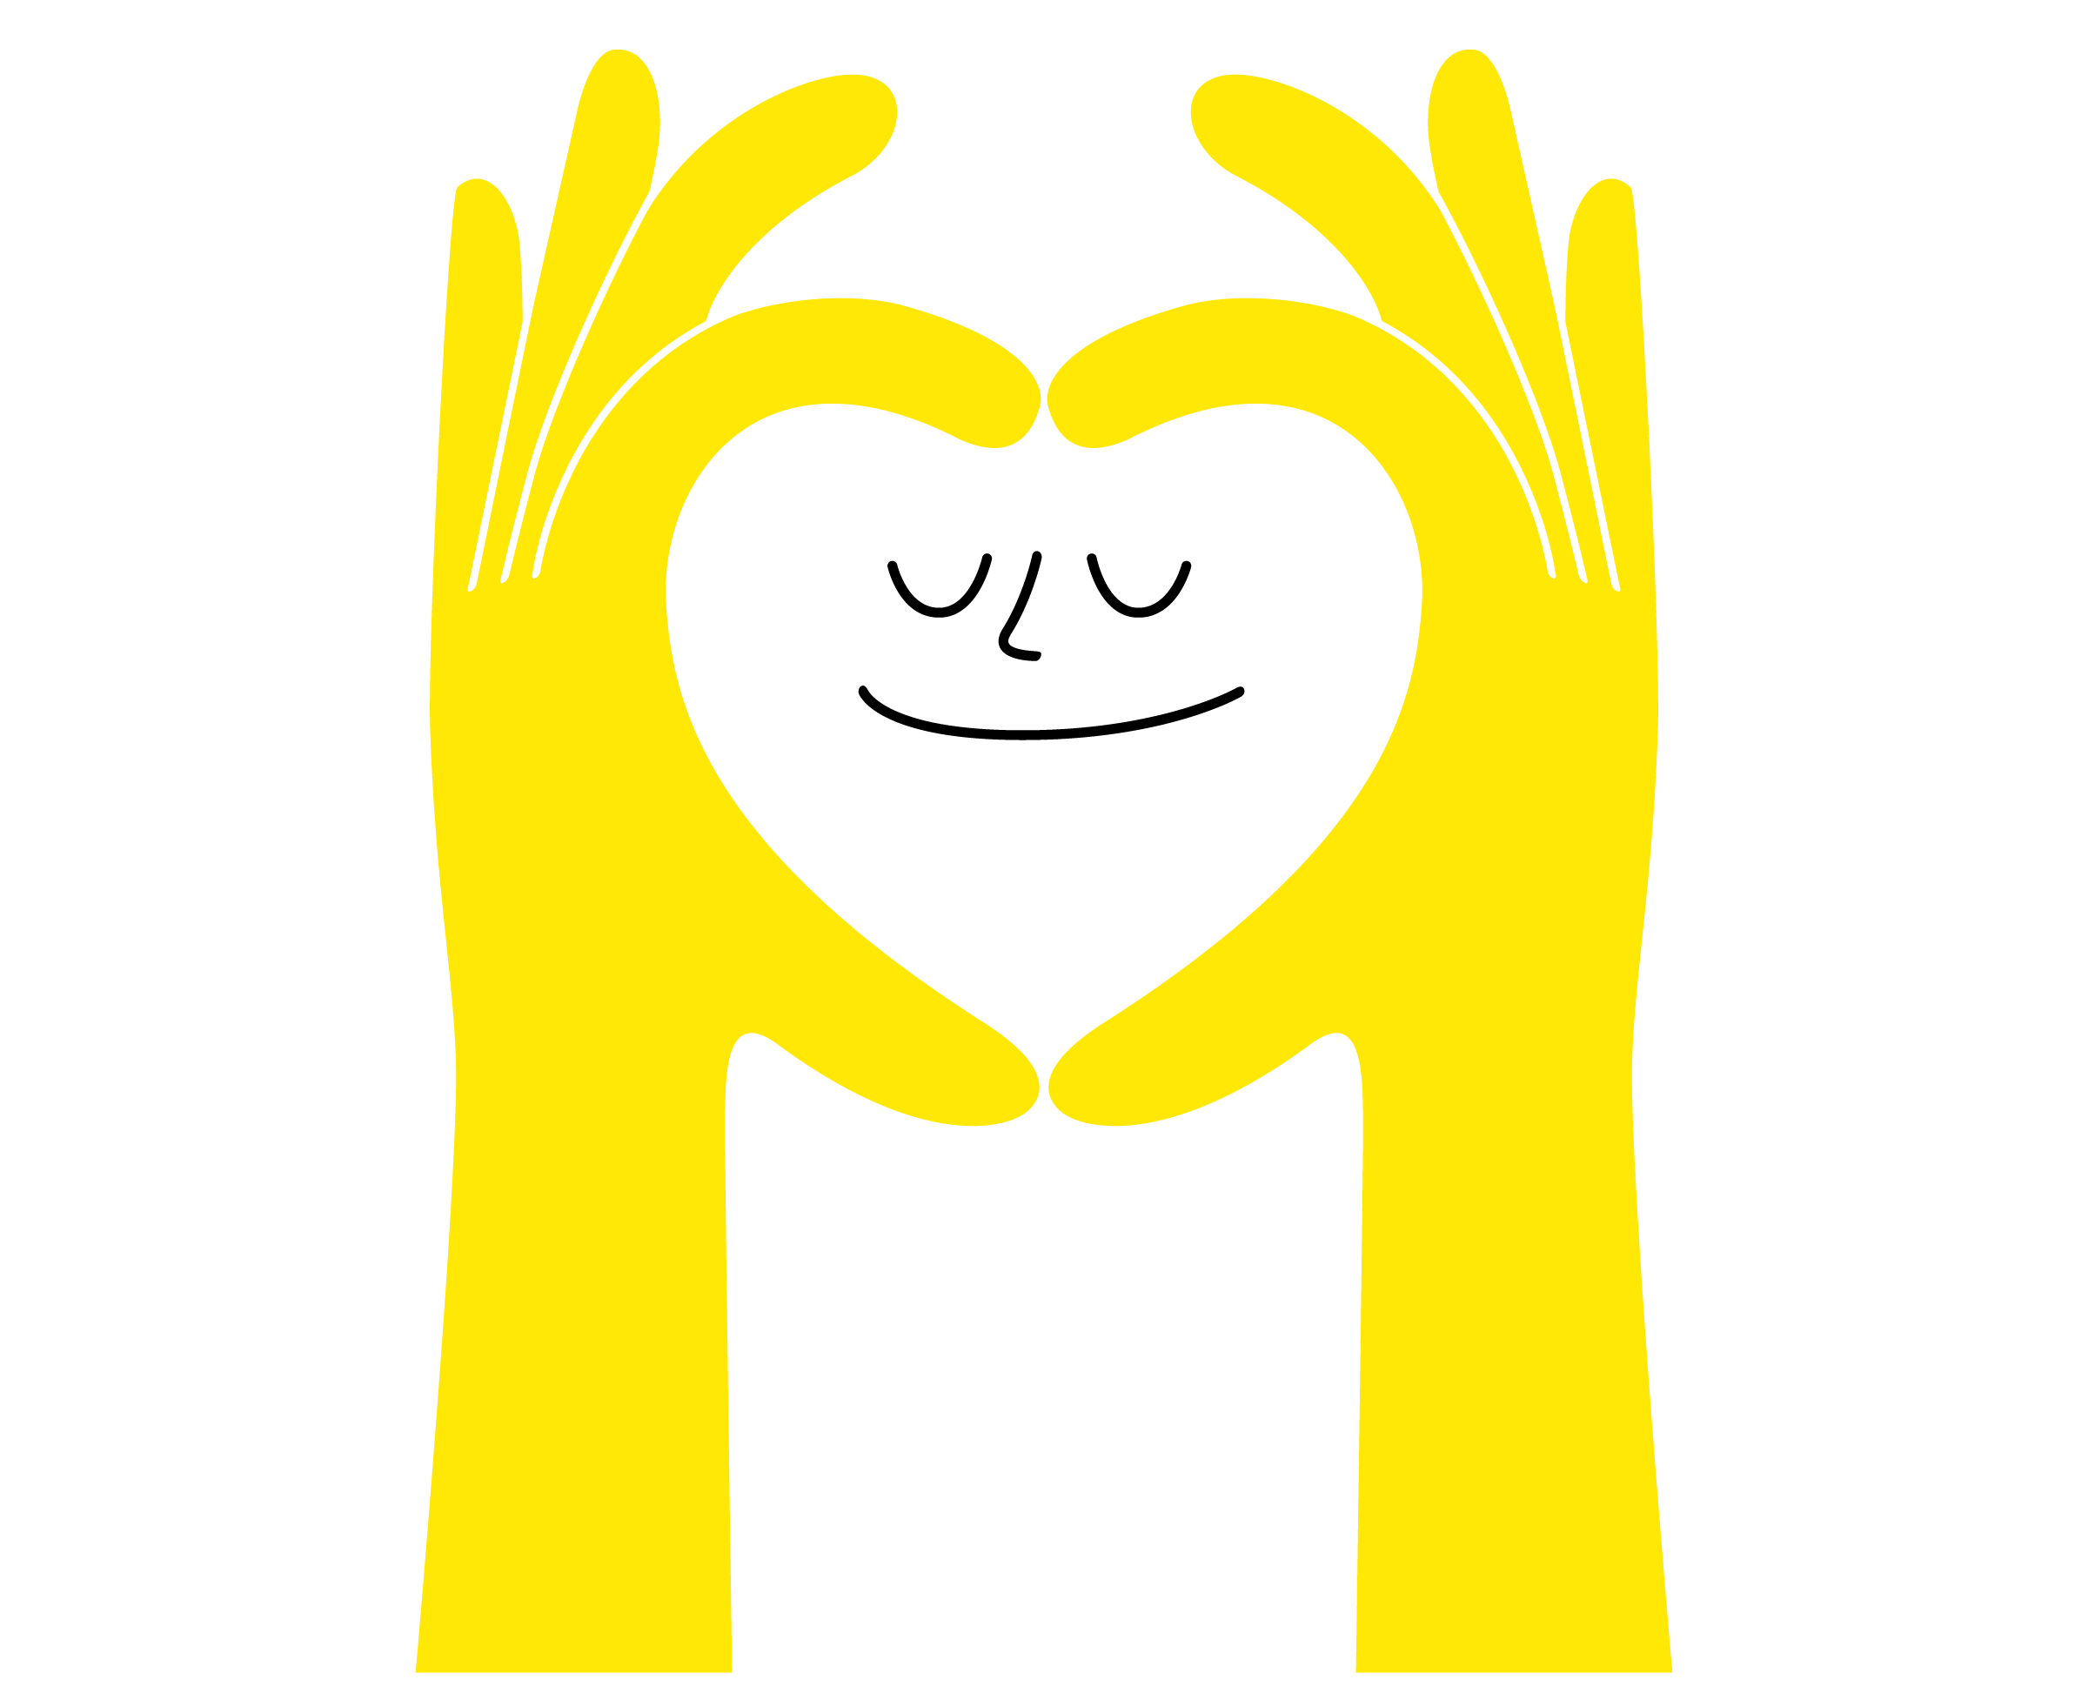
Daily Action
Independent Writing
Draw or write to show how you can add more well-being into your life at school, in your community,
and at home.

Slide 22
