Slide 1
1q

Slide 2
Lesson PowerPoint Table of Contents
Lesson 8: The Road to Empathy
Lesson 9: The Road to Compassion
Slides 3-18
What is empathy?
Empathy scenarios
Empathy reflection
Slides 18-30
What is compassion?
Compassion scenarios
Compassion reflection

Slide 4
First, find a comfortable seat.
Balloon Breathing
Then, close your eyes or pick a spot on the floor to focus on.
Next, notice what you hear around you.
After you settle into your comfy spot, focus on breathing in through your nose, out through your mouth.
Finally, imagine your belly is a balloon. Fill up nice and round before you exhale. Do this for 2 minutes.

Slide 5
The Cool Bean by Jory John
As you watch, think about how the characters in the story feel.

Slide 6
The Cool Bean by Jory John
The bean felt uncool and was embarrassed, so he could’ve had a really bad day, but…
He was okay and had a good day!
How was he able to have a good day even though some embarrassing things happened?

Slide 7
What is “Empathy”?
Think-Pair-Share
Have you ever heard the word “empathy” before?
Or maybe the saying “walking in someone else’s shoes?
What do you think these mean?

Slide 8
What is “Empathy”?
noun
Definition: Understanding and sharing the feelings of another person.
Think-Pair-Share
How do you think empathy can help us with creating a caring classroom?

Slide 9
Feelings Brainstorm
Bad Feelings
Middle Feelings
Good Feelings

Slide 10
Empathy Scenarios
Scenario:
A classmate found out she was not included in an invitation for the birthday party of another classmate.
Think-Pair-Share
What might the student be thinking?
What might the student be feeling?
3. Have you ever felt that way?

Slide 11
Empathy Scenarios
Scenario:
A classmate has worked on a science project about a topic they’re passionate about. They have put weeks of effort into the project and get selected to present their project in front of the whole school.
Think-Pair-Share
What might the student be thinking?
What might the student be feeling?
3. Have you ever felt that way?

Slide 12
Empathy Scenarios
Scenario:
One of your classmates has not studied for a test that you have tomorrow.
Think-Pair-Share
What might the student be thinking?
What might the student be feeling?
3. Have you ever felt that way?

Slide 13
Empathy Scenarios
Scenario:
A group of students at your school have started a fundraising campaign to give clean water access to a community in need. They received twice the amount of donations they expected, doubling their fundraising goal.
Think-Pair-Share
What might the student be thinking?
What might the student be feeling?
3. Have you ever felt that way?

Slide 14
Empathy Scenarios
Scenario:
A classmate scored the winning goal in their soccer game.
Think-Pair-Share
What might the student be thinking?
What might the student be feeling?
3. Have you ever felt that way?

Slide 15
Empathy Scenarios
Scenario:
Your friend is going to their very first karate class and they don’t know anyone there.
Think-Pair-Share
What might the student be thinking?
What might the student be feeling?
3. Have you ever felt that way?

Slide 16
Empathy Scenarios
Scenario:
Your friend lost their favorite necklace, which was a special gift from a loved one.
Think-Pair-Share
What might the student be thinking?
What might the student be feeling?
3. Have you ever felt that way?

Slide 17
Empathy Scenarios
Scenario:
A classmate really wants to play hide-and-seek at recess, but all of their friends want to play a different game.
Think-Pair-Share
What might the student be thinking?
What might the student be feeling?
3. Have you ever felt that way?

Slide 18
Share Out!
Which scenario reminded you the most of something in your own life?
When we notice someone feeling upset, what can we show them empathy?
How does empathy help our relationships with others?

Slide 20
First, find a comfortable seat.
Balloon Breathing
Then, close your eyes or pick a spot on the floor to focus on.
Next, notice what you hear around you.
After you settle into your comfy spot, focus on breathing in through your nose, out through your mouth.
Finally, imagine your belly is a balloon. Fill up nice and round before you exhale. Do this for 2 minutes.

Slide 21
Empathy Review
noun
Definition: Understanding and sharing the feelings of another person.
Think-Pair-Share
What is empathy to you in your own words?
Why is empathy important?

Slide 22
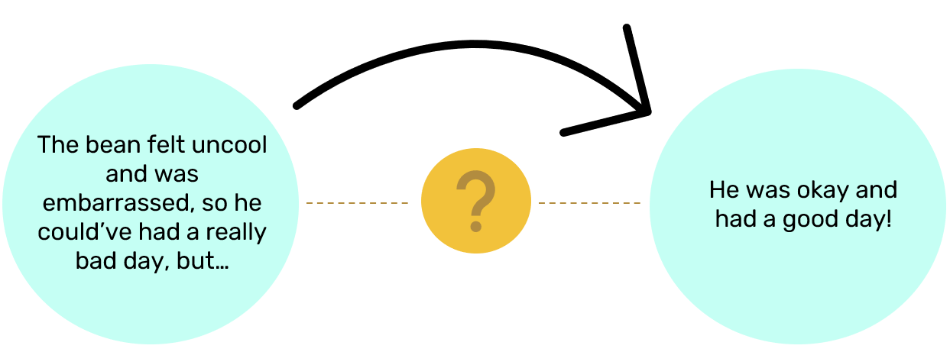
What is “Compassion”?
noun
Definition: Concern for the well-being of someone who is suffering and a desire to ease that person’s suffering.
Think back to the story The Cool Bean…
First,
Then,
The Cool Beans felt empathy for the main bean…
They showed compassion by helping the main bean.

Slide 23
What is “Compassion”?
Popcorn Thoughts
What does compassion look like in your life?
How might compassion help your friendships?
How do you see compassion in your community?
How is compassion the same or different from empathy?

Slide 24
Empathy vs Compassion
Compassion is like empathy in action.
First, we show empathy by understanding how a person feels.
Then, we can show compassion by doing something to try to make them feel better.

Slide 25
Compassion Scenarios
Scenario:
There is a new student joining the class.
Think-Pair-Share
What might the student be thinking and feeling?
Have you ever felt that way?
3. What actions could you take to show compassion?

Slide 26
Compassion Scenarios
Scenario:
A student is being teased.
Think-Pair-Share
What might the student be thinking and feeling?
Have you ever felt that way?
3. What actions could you take to show compassion?

Slide 27
Compassion Scenarios
Scenario:
A student lost their favorite toy in the schoolyard.
Think-Pair-Share
What might the student be thinking and feeling?
Have you ever felt that way?
3. What actions could you take to show compassion?

Slide 28
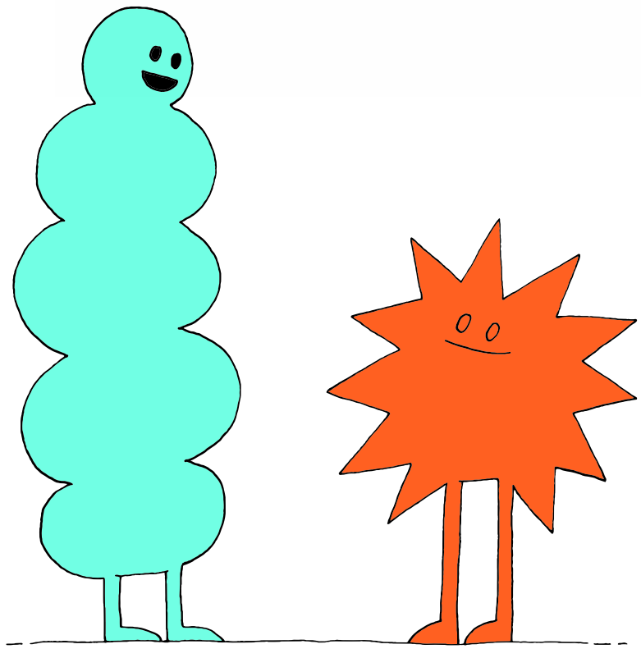
Share Out!
How do empathy and compassion help our relationships with others?

Slide 29
Empathy and Compassion Key Message
Empathy and compassion are important for our
well-being.
Empathy and compassion are central
to having positive relationships with others
because it helps us show others that we care.

Slide 30
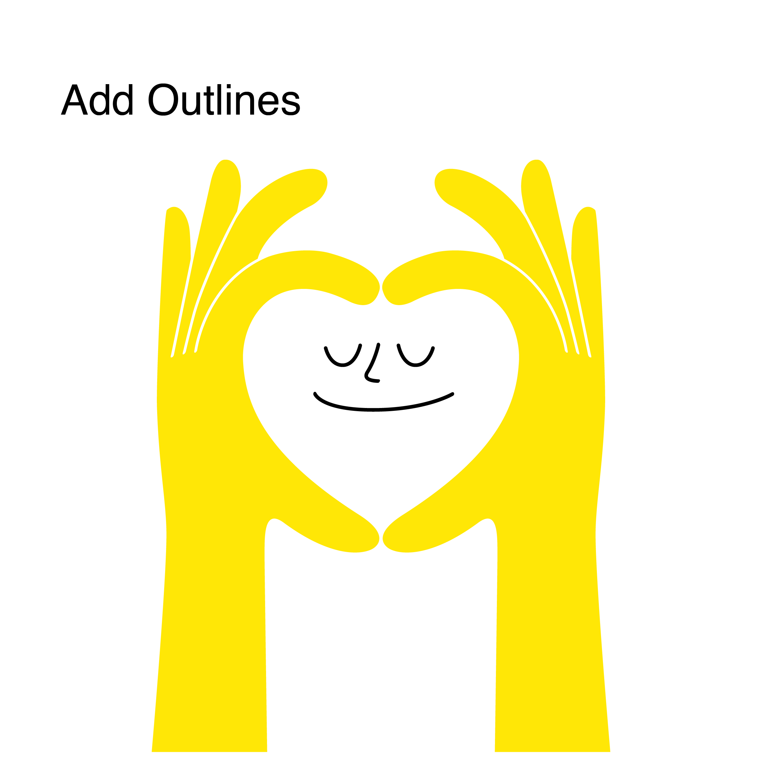
Daily Action
Independent Writing
Draw or write to show how you can add more empathy and compassion into your life at school, in your community,
and at home.

