Slide 1



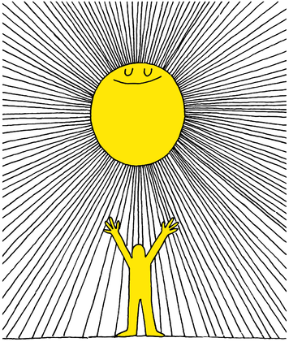

Slide 2

Lesson PowerPoint Table of Contents
Lesson 1: Let’s Get Started
Lesson 2: The Road to Mindfulness
Slides 3-11
  What is well-being?
  Learning about well-being
  Understanding your own well-being
Slides 12-19
  What is mindfulness?
  Practicing mindfulness
  Mindful breathing exercise
Lesson 3: Understanding our Feelings
Lesson 4: Managing our Emotions
Slides 20-27
  Reviewing mindfulness
  Recognizing feelings
  Understanding the effect of our feelings
Slides 28-34
  Reviewing mindfulness
  Recognizing feelings
  Understanding the effect of our feelings
Notes:
2

Slide 3




Slide 4

Well-being Poster Walk
What is Well-being?
Define it in words.
What does Well-being look like?
How can you tell if someone has a positive well-being?
What are some common stresses or disappointments you or your classmates might face?
What do you do to manage stress and disappointments?
What actions can you take to increase Well-being?
What questions do you have about Well-being?

Slide 5
Well-being Poster Walk- Class Discussion
What is Well-being?
Define it in words.
What does Well-being look like?
How can you tell if someone has a positive well-being?
What are some common stresses or disappointments you or your classmates might face?
What do you do to manage stress and disappointments?
What actions can you take to increase Well-being?
What questions do you have about Well-being?

Slide 6
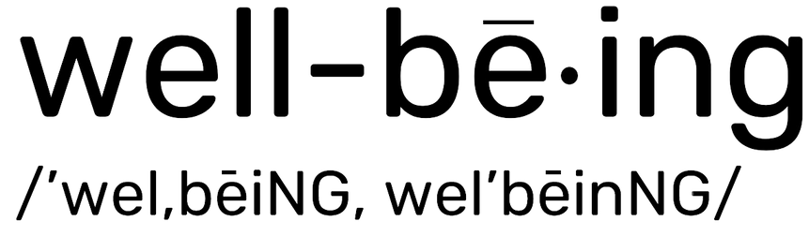
What is “Well-Being”?
noun
Definition: The state of being comfortable, happy, or healthy
  How does this definition relate to your thoughts about well-being?
  Were you surprised by any of the answers written on the papers around the room?
  Were there answers that made you more curious or that need expanding?

Slide 7
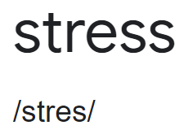
Well-Being Continued
noun
Definition: What you feel when you are worried or uncomfortable about something.
Caring for our well-being helps us manage stress and disappointments.
What does managing stress look like for you?
Why is it important?

Slide 8
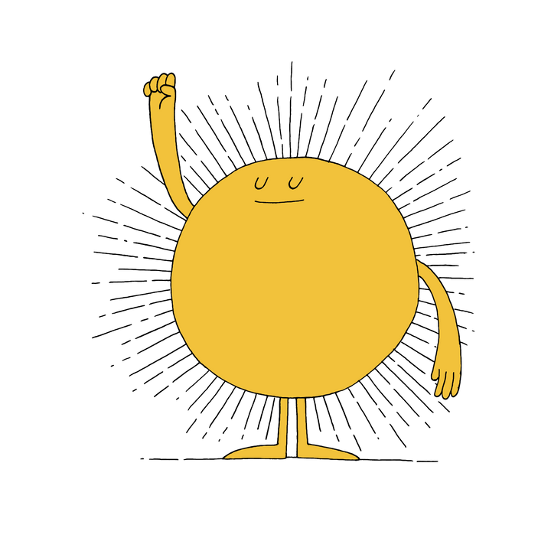
Affects of Stress
When our stress feels out of control, it can affect our mood and our relationships
    Have you ever felt your mood affected by stress?
    Why do you think stress can affect our relationships? Have you experienced that before or seen it happen?
When we are able to manage our stress and disappointments, we are able to do our best and help others.

Slide 9
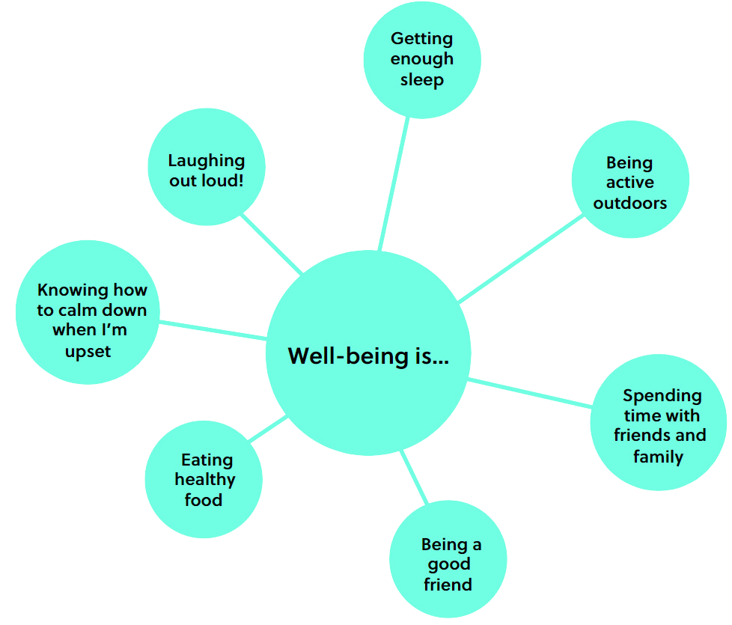
How can we increase our well-being?
Here are some ways we can increase our well-being...
  Did we think of anything different on our poster?
  Which way is your favourite?
  Can you give an example of a time you used one of these to boost your well-being?
Notes:
6

Slide 10

Journaling
Notes:
Teacher notes: There is a printable version of this bubble map in our Well-Being Canada resources, so you can…
- Print the web out and have your students complete this independently first
- Print the web out and have students complete in partners or small groups first
- Project the web on your board and complete together as a class
The following slide shows sample answers so your class can compare your answers with ours!
7

Slide 11
Final Thoughts
What do you think well-being...
      looks like
      sounds like
      feels like
Notes:
8

Slide 12

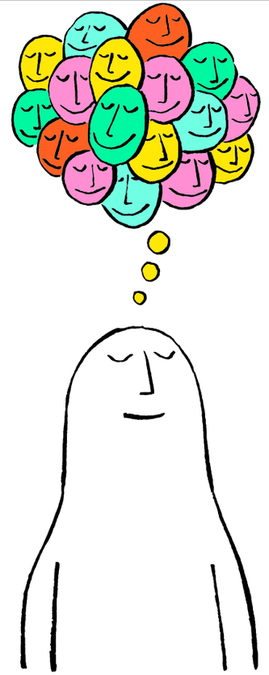

Slide 13


What is Mindfulness?
Think-Pair-Share
Have you ever heard the word “mindfulness?”
If so, what does it mean and give an example.
If not, what do you think it means?
Notes:
12

Slide 14
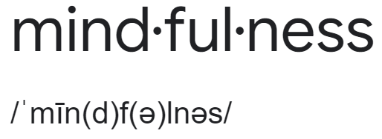
What is Mindfulness?
noun
Definition: Paying full attention to what is happening in the moment, without judgement.
Think-Pair-Share
What do you think it means to pay attention to what is happening in the moment?
What do you think “without judgement” means?
Notes:
12

Slide 15

Unpacking Mindfulness
  giving your full attention and interest
  keeping an open mind about what you are seeing or hearing (that’s the “without judgement” part!)
  the opposite of rushing or multitasking
  being curious about the “here and now”
  focusing in a relaxed, easy way
Think-Pair-Share
Why do you think practicing mindfulness is good for your well-being?
Notes:
13

Slide 16
Let’s practise!
Imagine your friend goes on vacation and comes back telling you about a band that you have never heard before.
What would it look like to listen to this music without judgment?
Notes:
14

Slide 17
Mindful practises: Listening
Today we’re going to do a short simple mindfulness exercise to attune your mind and your body.
Listen with your whole body, not just your ears. If you feel like it, let the music move you. Feel the beat, give yourself over to the rhythm, and bring your full attention to the music and the movement.
Notice...
  thoughts of embarrassment or shyness, or thoughts like, “This is ridiculous.”
  feelings that are released: anger, joy, sadness…
  what your body is feeling; feel its aliveness.
Notes:
19

Slide 18
Listening practise Reflection
Take this time for yourself to reflect on these questions and write your answers...
  What was it about this activity that promoted mindfulness?
  How did you feel when you listened to the music?
  Did you notice your emotions shifting or changing? When?
  What sort of thoughts did you have as you listened?
  How did your body respond to the sounds and rhythms of this piece?
  What’s the difference between hearing music and listening to music with your whole self (thoughts, feelings, body)?
  How do you feel now?
Notes:
19

Slide 19
Other Mindful Practises
  Guided visualization
  Mindful movement
  Mindful walking
  Mindfulness in nature
  Mindful art
  Mindful communication
Notes:
18

Slide 20

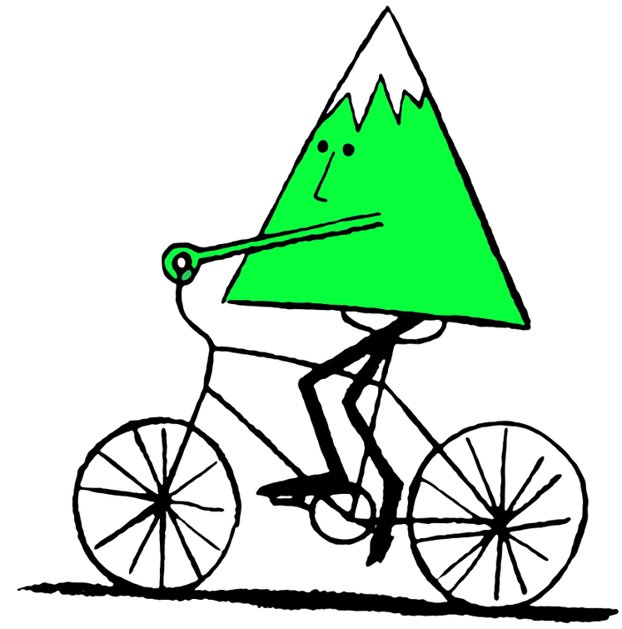


Slide 21
Review
Think-Pair-Share
What is well-being?
What is mindfulness?
Notes:
21

Slide 22
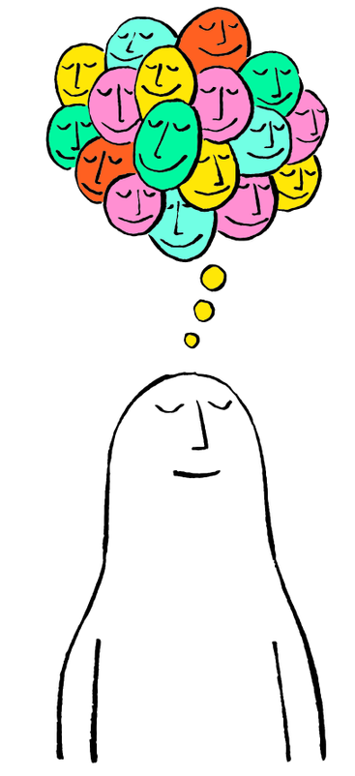
Mindfulness Practise of Choice
Notes:
22

Slide 23
Journaling
  How did the activity help to clear your mind?
  Do you think you are more focused now?
  Write about any mindfulness experiences you have had this week.
Notes:
23

Slide 24
What are goals and intentions?
Think-Pair-Share
What are goals?
Can you give an example of a goal you have or have had?
Have you ever heard of intentions? What do you know about setting intentions?
Notes:
21

Slide 25




What are Intentions?
Let’s compare/contrast a goal vs intention…
noun
Definition: Something you are trying to do or achieve.
noun
Definition: A determination to act in a certain way.
Notes:
24

Slide 26
Goals vs Intentions
Goals
Intentions
  Final achievement or destination
  “External”
  Something you want to attain in the future
  Something you plan to do regardless of the outcome
  More about your attitude
  Focused on the present
  The “how” you do something
Examples:
Examples:
  Being kind to others
  Being patient with your sibling
  Listening to other’s point of view
  Getting an A in math
  Learning a new skateboard trick
Notes:
25

Slide 27
Journaling
Think back to a recent memorable day.
Do you think anything may have gone differently if you had set intentions in advance? Why? How?
Write your response.
Notes:
26

Slide 28

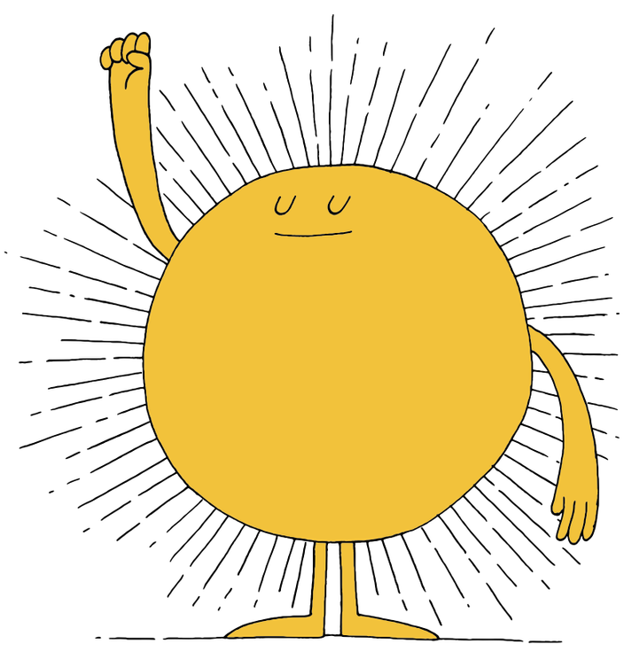


Slide 29
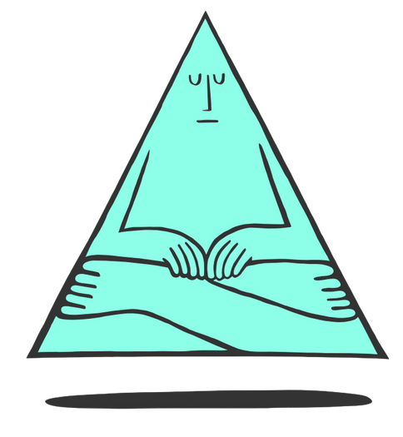
Intention Setting Visualization
Closing your eyes (if you’re comfortable), think to yourself…
  When are you your truest, best self?
  What does it look like, sound like, and feel like?
  Hold that image of yourself in your mind
  When you’re ready, open your eyes.
Notes:
30

Slide 30
Journaling
Take this moment to quietly reflect on what it would be like to be the best version of yourself. Use these prompts below to help you, if needed:
  What kind of friend would you be?
  How would you act in school?
  What would you do to be a good teammate or be successful in sports?
Notes:
Teacher Note: A printable version of this sheet can be found in the lesson package
31

Slide 31
Definitions Recap
  Well-being: The state of being comfortable, healthy or
  happy.
  Mindfulness: To pay attention to what is happening in
  the moment, without judgment.
  Goal: Something that you are trying to achieve.
  Intention: A determination to act in a certain way.
Notes:
32

Slide 32
Prepare to Set Intentions
Example: I feel happy when I play my favourite sport.
Intentions:
    Make an effort to find time to play
    Instead of watching TV, go outside
    Notice how you feel when you play
    Be mindful when you play
Example: I am my best self when I’m a good friend.
Intentions:
    Be kind
    Let go of grudges
    Include others
    Help others feel part of a community
Notes:
33

Slide 33


Creating a Personal Plan
Independent Writing
Describe an intention for today that helps you be your best self.
Prompts to help you think:
  Where do I want to focus my time and energy?
  Where do I need more consistency?
  What changes or improvements do I need to make?
  What habits/practises are working well?
  What do I need more of?
  What do I need less of?
  What am I committed to?⁠
Notes:
34

Slide 34

Share out!
If you are comfortable, share your intention for today.
Notes:
35

Slide 35
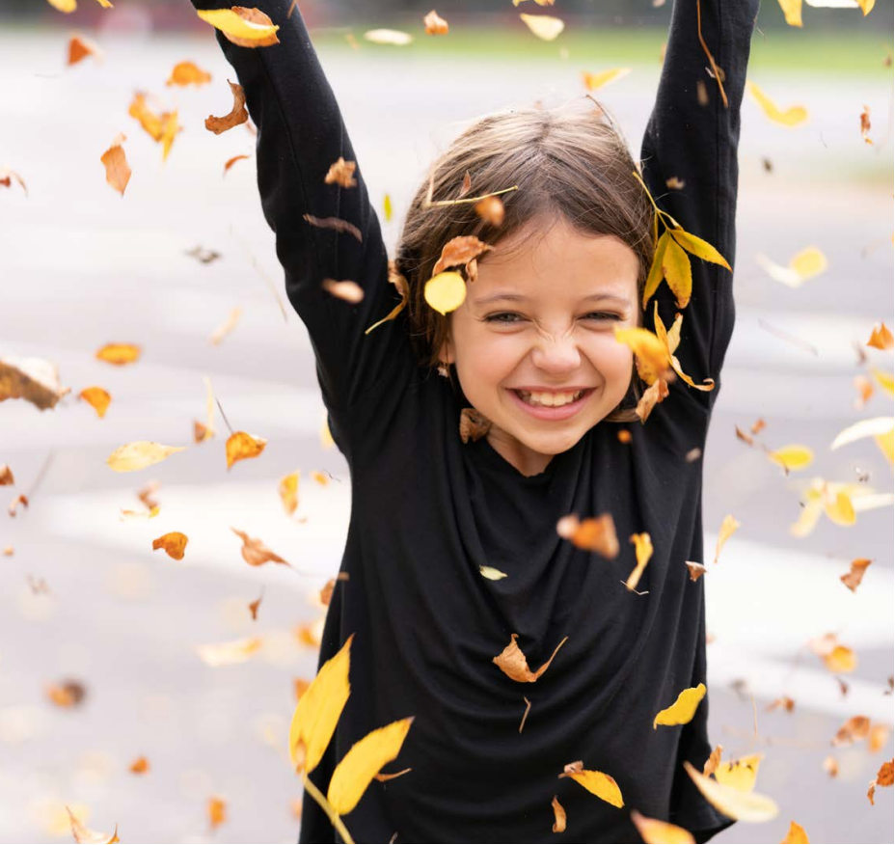
Thank you!

