Slide 1
GRADES 7 and 8
Lessons 14 - 16
THE ROAD TO POSITIVE WELL-BEING IN EVERY CLASSROOM STARTS HERE

Slide 2
Lesson PowerPoint Table of Contents
Lesson 14: The Road to Resilience
Lesson 15: Acting with Resilience
Slides 3-13
What is resilience?
How is resilience shown?
Can we build resilience?
Slides 14-21
Reflecting on your resilience
Self-care and resilience
Making a self-care plan
Lesson 16: Reflecting on and Celebrating Well-being
Slides 22-31
Well-Being review
Well-Being reflection
Well-Being going forward

Slide 4
Review
Think-Pair-Share
What is altruism?
How is altruism different than kindness?
How does altruism help build a caring community?
Have you had any new experiences with empathy or compassion?
Notes:
5

Slide 5
Mindfulness Practise of Choice

Slide 6
Video Scenario

Slide 7
Video Response
Independent Writing
What Ali’s hope has been during her acting career.
What the challenges Ali Stroker described that she has faced.
How did she overcome them?
Notes:
7

Slide 8
Share Out!
Share your writing with a partner or with the class.
What can we learn from Ali’s story?
Notes:
8

Slide 9
What is “Resilience”?
noun
Definition: trying our best, even when things are difficult. Doing well in life despite adversity.
Think-Pair-Share
Use the word resilience or resilient in a sentence, or put the definition in your own words.

Slide 10
Share Out!
Popcorn Thoughts
What do you think “adversity” is? Can you think of any examples?
How does the definition of resilience relate to the video we watched?
Why might resilience be helpful in life?

Slide 11
Movie Scenario

Slide 12
Movie Scenario Discussion
We often want to “run away” from our problems or challenges. Why is this a natural response to any challenges?
Why is “running away” from problems an unhealthy way of coping with challenges?
After Rocky’s speech, his son begins to reflect on who he is and what he stands for. How is Robert’s experience similar to practising mindfulness?
Resiliency means to change yourself by stepping outside of your comfort zone and growing from that experience. How will Robert embrace his uncomfortable emotions and feelings? What values will he reflect on?
Notes:
12

Slide 13
What do you think?
Think-Pair-Share
Do you think that you can build resilience or become
more resilient? Why or why not?
Notes:
13

Slide 14
Acting With Resilience

Slide 15
Mindfulness Practise of Choice

Slide 16
Journaling
Think back to a day that didn’t go well (within your control). Write and draw about what you could have done differently to help that day be better.
Independent Writing
How could setting an intention have changed how you felt that day?
Rewrite the ending of that day if you had set an intention.
Were there any factors like being hungry, not having enough sleep, not setting aside enough time that might have influenced whether the day would have gone better?
Notes:
7

Slide 17
Self-care and Resilience
Today, we’re going to think about what areas in our life that have required us to have resilience. A way to build resilience and find peace in your life is to put activities into your life and create routines or schedules.
As we watch this next video, think about areas in your life where you need to build resilience and how increasing your self-care could help.
Notes:
7

Slide 18
Self-care and Resilience
Notes:
7

Slide 19
Self-care and Resilience
Adding some structure to our routines can increase our resilience and well-being.
For example, maybe you are having trouble getting to school on time. Packing your backpack the night before can take away some morning stress. Or having a set bedtime to make sure you are getting enough sleep.
With a partner, take out your journal and write down areas that might need more structure. Consider areas that cause you stress or create conflict with family or friends. (for example, getting homework done, practicing an instrument, having less screen time, having time with friends).
Notes:
7

Slide 20
Implementation
Now that you’ve come up with a self-care plan, the next step is to make sure you carry out your plan!
Every few days, we are going to reflect in our journals about how our self-care plans are going. It takes a little while for something to become a habit, but just start a little at a time and celebrate those successes!
Some things to help you get started are to:
set reminders
be flexible about materials or time you have
remember your increased resilience and well-being is your reward!
Notes:
7

Slide 21
Journal Reflection
(after a month or so)
at what point did the action become part of their day without much thought? If you’re not there yet, what do you think you can do or change that may help?
did they notice less stress within themselves?
did they notice less stress with others?
are there other areas where this system might help?
are there any changes to the routine or schedule that they need to make to ensure that this will become sustainable?
Notes:
7

Slide 22
LESSON 16:
Reflecting On and Celebrating Well-being

Slide 23
Mindfulness Practise of Choice

Slide 24
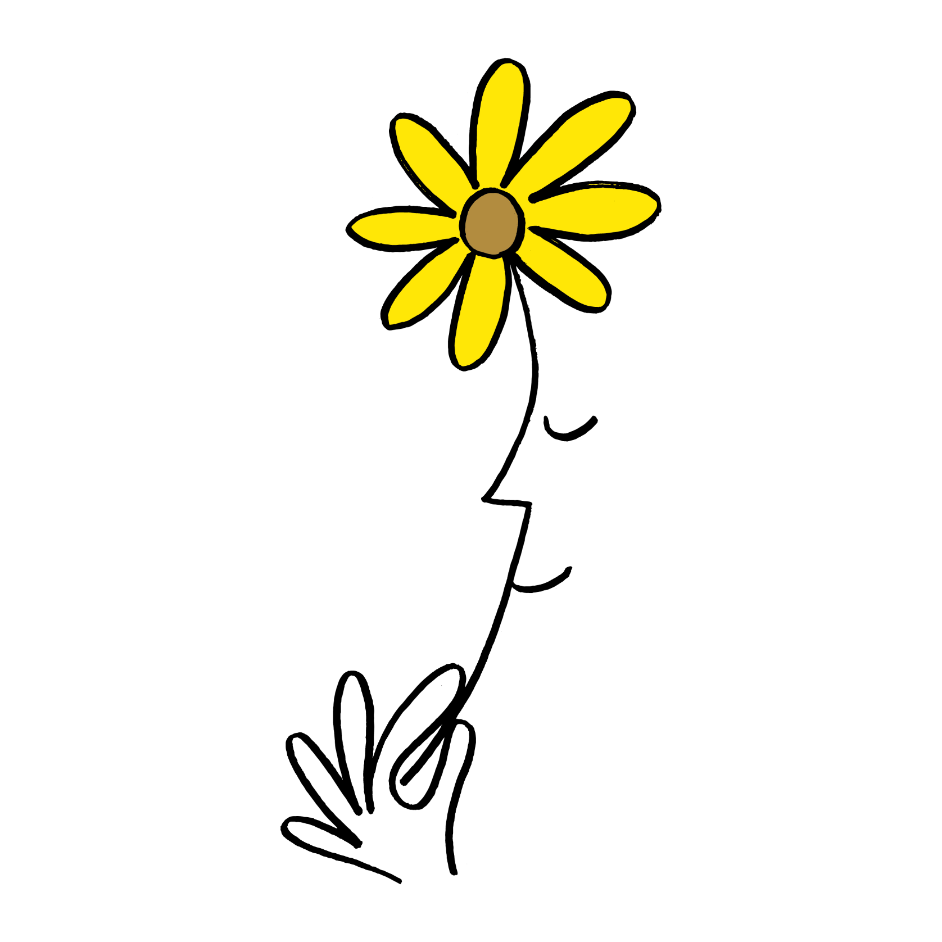
A Walk Down Memory Lane
Think-Pair-Share
What do you know about well-being?
Remember, we learned about:
Mindfulness
Gratitude
Empathy
Compassion
Altruism
Resilience
Notes:
19

Slide 25
Reflection
Independent Writing
Write or draw about your experience promoting well-being.
What did you notice about yourself?
What did you notice about others?
What more could you do to promote well-being?
When we’re done, share with a partner!

Slide 26
Well-Being Station Rotations
Station 1: “A Great Memory”
Practise gratitude and recall a moment during the past week or so that made you smile.
Station 2: “I am kind, or I help others, by…”
Consider empathy, compassion and altruism—how do you make a difference to others?
Write down one idea.
Station 3: “If I have a problem, I can go to…”
When you have a problem or a big worry, write down someone you could go to for help (for example, a parent or coach).
Station 4: “This week I did _______ because it made
me happy.”
What is something you did for yourself? What are things that you do to bring joy to your life?
Station 5: “What is a habit or routine that you engage
in that helps your well-being or the well-being of
others?”
Eating at regular intervals, a set bedtime, weekly meetings of a club...
Notes:
Teacher note: At each station you can have:
- a large piece of chart paper for students to add to the same paper (may want to use sticky notes to reuse the chart paper)
- provide paper for each student so they can do their own work
- get creative! For example, for station 1 they can paint a picture, station 2 they can act out helping others, for station 3 they can retell a time where they had a problem and needed help
15

Slide 27
Share Out!
Popcorn Thoughts
What were your favorite activities?
What is something new that you learned?
Are you doing anything different now to care for your well-being?
Are you helping others care for their well-being?

Slide 28
Daily Action
Independent Writing
As we look at the following Daily Actions, choose one that you are going to try and reflect on it in your journal.
Notes:
23

Slide 29
Daily Action
Notes:
24

Slide 30
Daily Action
Notes:
25

Slide 31
Daily Action
Notes:
26

