Slide 1




GRADES 7 AND 8
THE ROAD TO POSITIVE WELL-BEING IN EVERY CLASSROOM STARTS HERE

Slide 2

Lesson PowerPoint Table of Contents
Lesson 8: The Road to Empathy
Lesson 9: The Road to Compassion
Slides 3-19
  What is empathy?
  Empathy scenarios
  Empathy reflection
Slides 20-32
  What is compassion?
  Compassion scenarios
  Compassion reflection

Slide 3





Slide 4



Review
Think-Pair-Share
What is well-being?
What is mindfulness?
How can we practise mindfulness?
How does mindfulness support our well-being?
What is the difference between setting a goal and setting an intention?
Notes:
4

Slide 5

Mindfulness Practice of Choice

Slide 6
Set the Stage
Have you ever heard the saying “put yourself in someone else’s shoes?
What do you think that means?
Notes:
6

Slide 7

Putting Yourself in Someone Else’s Shoes
Teachers: See “Notes” section for when to pause and questions to ask
Notes:
Stop at :28. Ask the students to write what the person with the headphones thinks about the other person on the bench. Next, they should write what THEY think about the person on the bench.
Stop at 1:13. Ask students to write who they think is wearing those shoes.
Stop at 1:42. Ask students to write who they think is wearing those shoes
Stop at 2:07. Ask students to write what they think the shoes represent or why the person sees all these shoes.
Write what they think the yellow running cleats might show?
Stop at 2:37 have the students write why the person gave the other person the shoes.

Slide 8
Video Response
Think-Pair-Share
What was the person with headphones thinking when he first saw the other person without shoes?
  How did picking up the different shoes change the person’s thinking?
  What do you think the experience would have been for someone with the yellow cleats?
  What caused the person with the headphones to give the other person his shoes?
  What does the expression “put yourself in someone else’s shoes” mean?

Slide 9


What is “Empathy”?
noun
Definition: Understanding and sharing the feelings of another person.
Think-Pair-Share
How does empathy relate to the video we watched?
What does empathy look like in your life?
How might empathy impact your friendships? Your community?

Slide 10
Identifying Emotions
Scenario:
Your friend failed her math test.
Think-Pair-Share
  What might your friend be feeling?
  What might you say or do for your friend?
Notes:
10

Slide 11
Identifying Emotions
Scenario:
Your friend didn’t get a part in the school play.
Think-Pair-Share
  What might your friend be feeling?
  What might you say or do for your friend?
Notes:
10

Slide 12
Identifying Emotions
Scenario:
Your friend’s cat passed away.
Think-Pair-Share
  What might your friend be feeling?
  What might you say or do for your friend?
Notes:
10

Slide 13
Identifying Emotions
Scenario:
Your classmate got in an argument with his friends and they don’t want him to sit with them at lunch anymore.
Think-Pair-Share
  What might your friend be feeling?
  What might you say or do for your friend?
Notes:
10

Slide 14
Identifying Emotions
Scenario:
Your friend just found out his parents are getting a divorce.
Think-Pair-Share
  What might your friend be feeling?
  What might you say or do for your friend?
Notes:
10

Slide 15
Empathy Scenario #1
Let’s listen in on the discussion between Marc and Kendall and reflect on the empathy (or lack thereof) that is shown.
*Script on next slide, if needed
Notes:
14

Slide 16
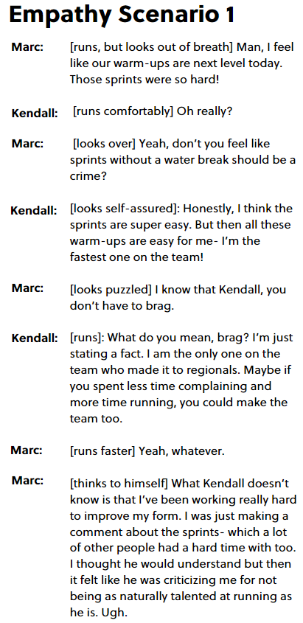
Empathy Scenario #1 Script

Slide 17
Empathy Scenario #2
Now, let’s listen to Shawn and Beck have the same discussion and reflect on the empathy (or lack thereof) that is shown.
*Script on next slide, if needed
Notes:
14

Slide 18
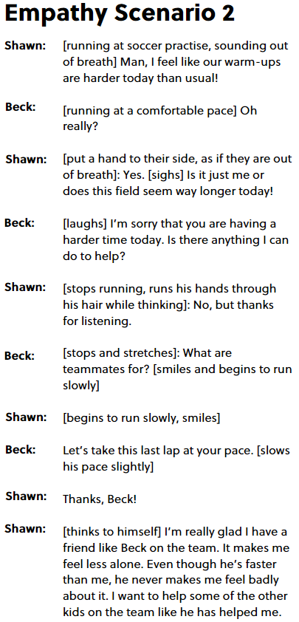
Empathy Scenario #2 Script

Slide 19
Reflection
  Would anyone feel comfortable sharing a time when someone truly understood how they were feeling and made them feel less alone?
  When we seek to understand someone else better, we open ourselves up to a world of possibilities.
  What is it like to be someone else?
  How can our curiosity make us a better friend or sibling?
  How does empathy help our relationships with others?
Notes:
14

Slide 20




Slide 21
Empathy Review
noun
Definition: Understanding and sharing the feelings of another person.
Think-Pair-Share
What is empathy to you in your own words?
Why does empathy help our relationships?
Notes:
19

Slide 22
Mindfulness Practice of Choice

Slide 23


Journaling
“No matter who we are, no matter how successful, no matter what our situation, compassion is something we all need to receive and give."
- Catherine Pulsifer
Independent Writing
When you hear this quote, what does it mean to you?
What do you think it is about?
Notes:
21

Slide 24
Quote Reflection Share Out
“No matter who we are, no matter how successful, no matter what our situation, compassion is something we all need to receive and give."
- Catherine Pulsifer
When you hear this quote, what does it mean to you?
What do you think it is about?
Notes:
22

Slide 25




What is “Compassion”?
noun
Definition: Concern for the well-being of someone who is suffering and a desire to ease that person’s suffering.
First,
We feel empathy.
Then,
We show compassion.
Notes:
23

Slide 26


What is “Compassion”?
Popcorn Thoughts
  What do you already know about compassion?
  How is compassion the same or different from empathy?
  What does compassion look like in your life?
  How might compassion help in your friendships?
  How does compassion impact our community?
Notes:
24

Slide 27
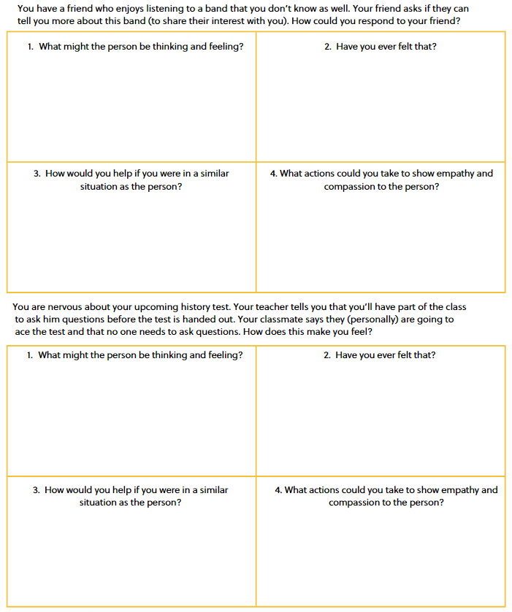
Empathy Scenarios
Notes:
14

Slide 28
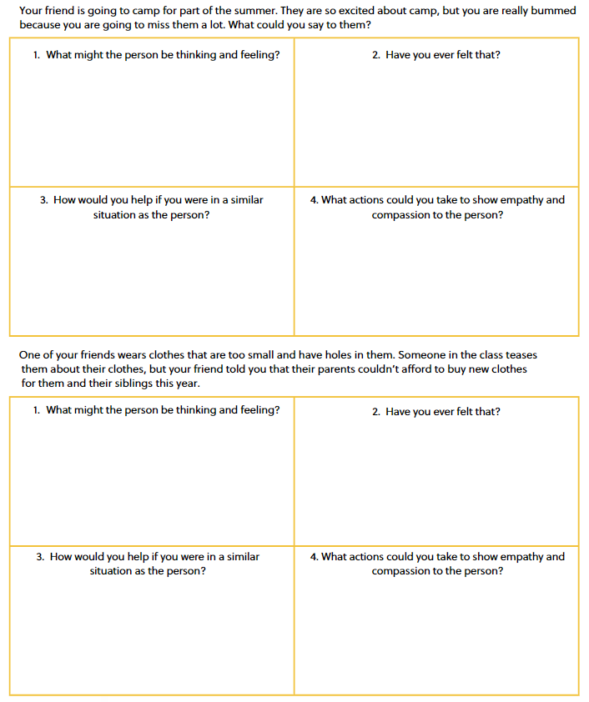
Empathy Scenarios (con’t)
Notes:
14

Slide 29
Empathy Scenarios- optional
Empathy scenario skits:
  There is a new student joining the class
  A student is being teased (what would the bystanders do?)
  A student is left out of a game
Notes:
14

Slide 30

Share Out!
Share your ideas for showing empathy and compassion in each empathy scenario example.
Notes:
29

Slide 31
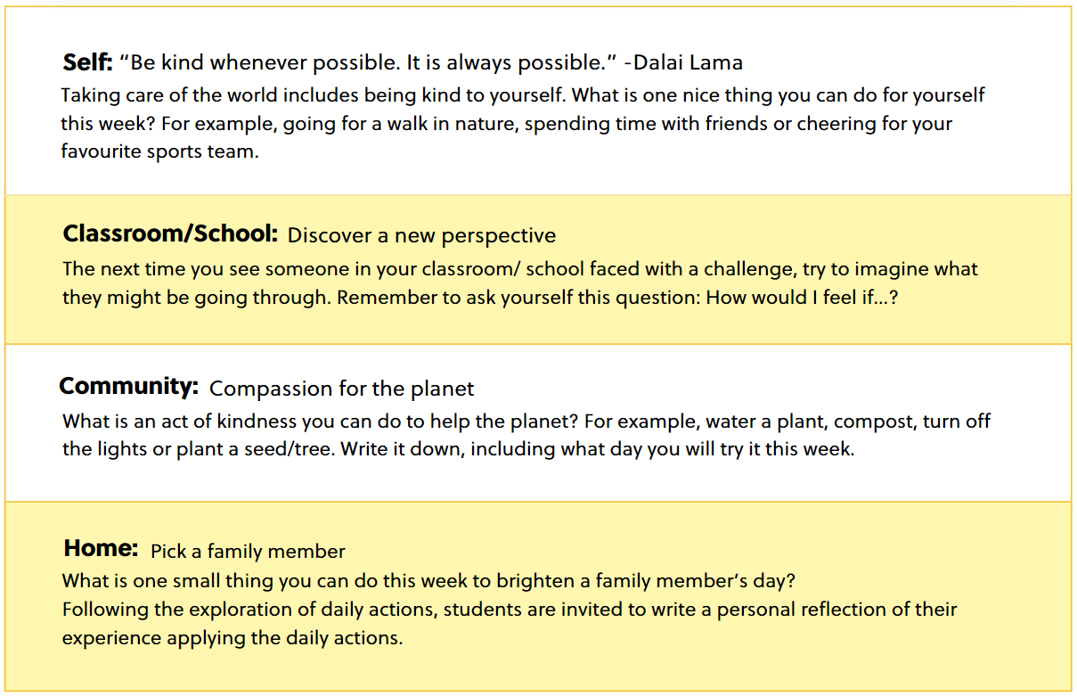
Daily Actions
Consider which daily actions you can include into your daily life...
Notes:
32

Slide 32
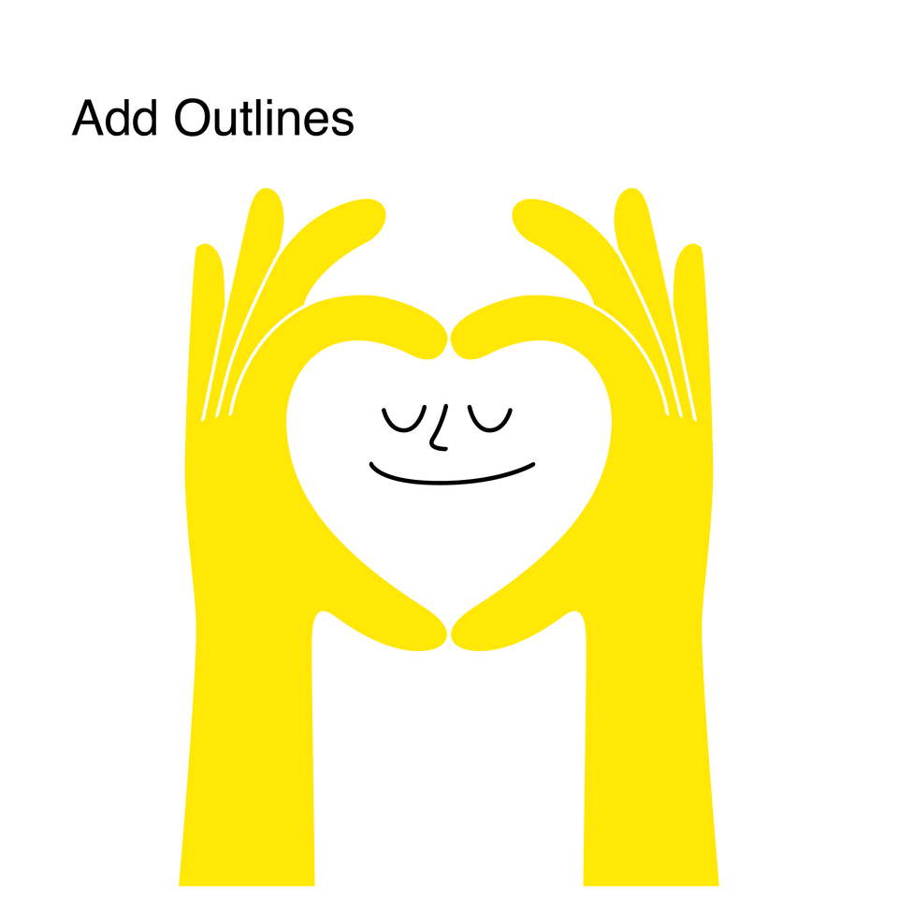
Journaling
Independent Writing
Draw or write to show how you can add more empathy and compassion into your life at school, in your community, and at home.
Notes:
33

Slide 33


